Slide 1





Discovery of a hydrothermal fissure in the Danakil depression
Daniel Mège¹, Ernst Hauber², Mieke de Craen³, Hugo Moors³, Christian Minet⁴
¹Space Research Centre, Warsaw, Poland
²German Aerospace Centre, Berlin, Germany
³Nuclear Research Centre, Mol, Belgium
⁴German Aerospace Centre, Oberpfaffenhofen, Germany

Slide 2
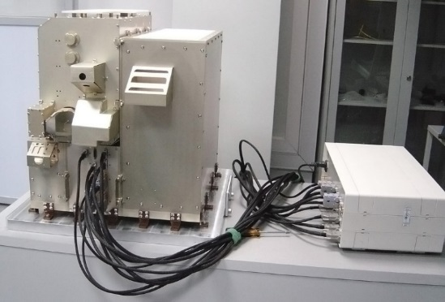
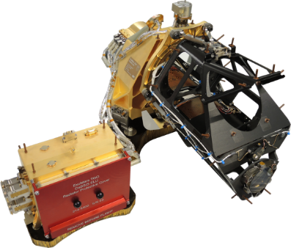
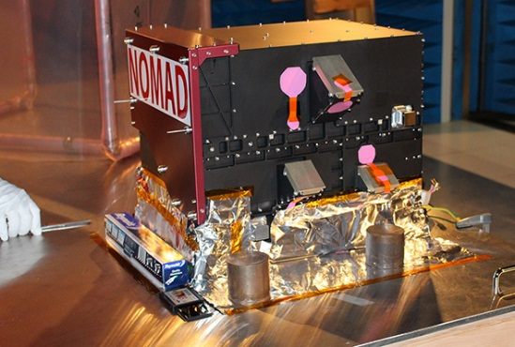
Rationale
Some of the past, and perhaps present, hydrothermal activity on Mars is related to volcanic fissures in "rift" zones.
Biological activity in such environment develop irrespective of climate conditions, it is rather controlled by local crustal and fluid properties, making comparison between their terrestrial and martian geoenvironments particularly relevant.
The Danakil rift is even more attractive as a terrestrial rift analogue because of the evaporitic environment.
Investigating the geomorphology and structure of the Danakil rift, correlated with the biological content of its hydrothermal sites, may therefore provide useful about environments on Mars prone to current and past biological activity to be expected.
Such environments may be detected by ExoMars TGO instruments.
ACS
CaSSIS
NOMAD

Slide 3
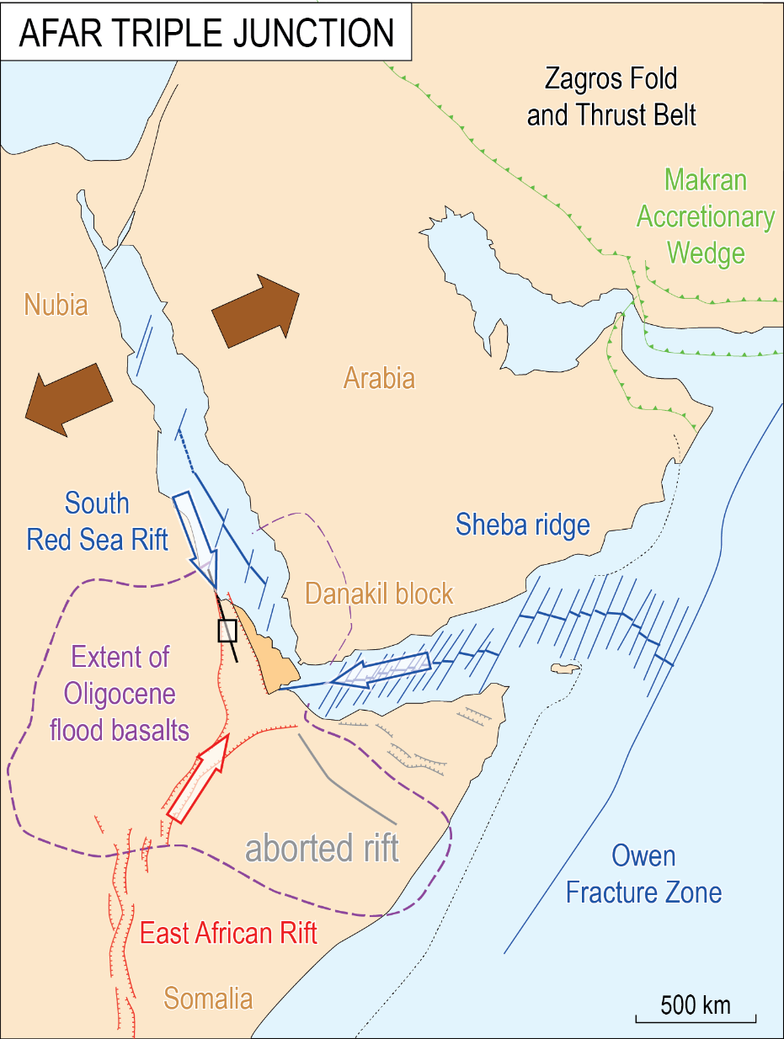
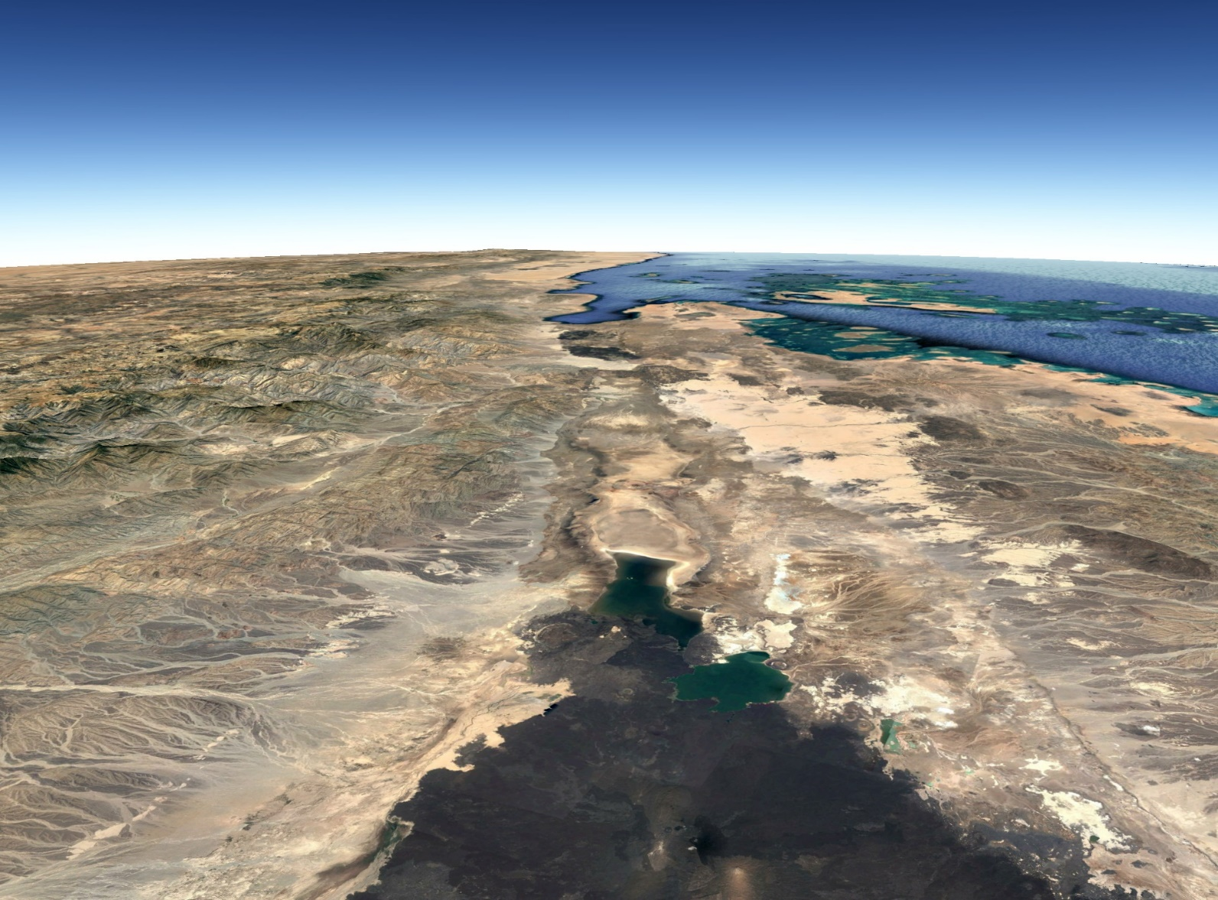
Geologic context
North
Gulf of Zula
Alid volcano
NUBIA
DANAKIL BLOCK
Dallol dome
Lake Karum (Asale)
Gada ‘ale
Erta’ale
after Mège et al. 2015

Slide 4
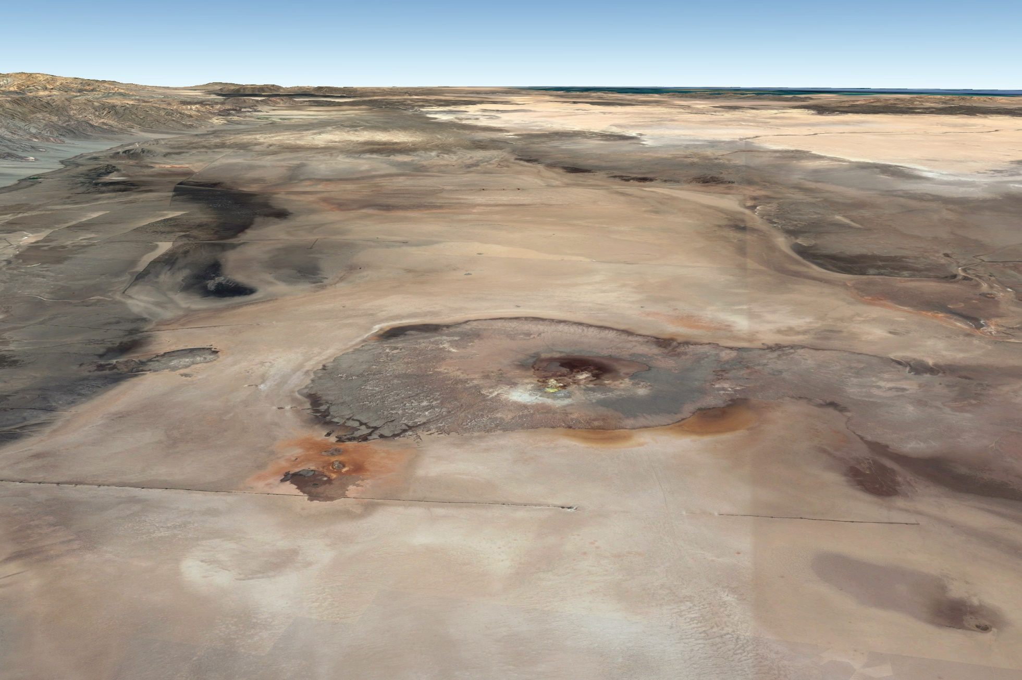
Geologic context
North
Dallol dome (-80 m)
Danakil depression (-120 m)

Slide 5
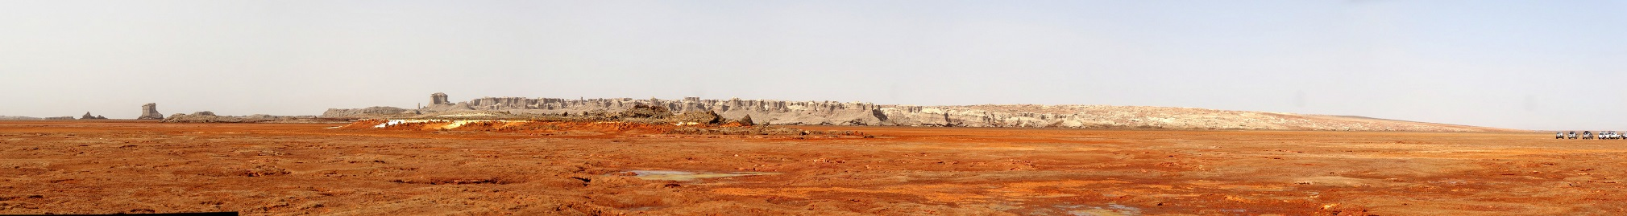
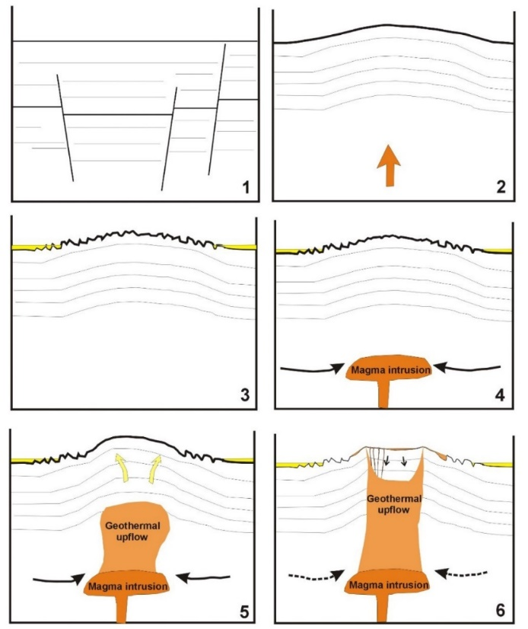
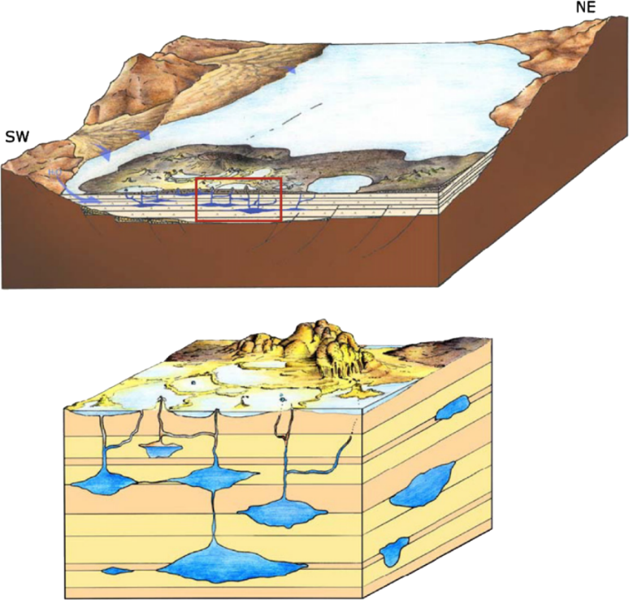
The Dallol hydrothermal system
Evaporite deposits
(1000 m or more)
Carniel et al. 2010
Franzson et al 2015

Slide 6
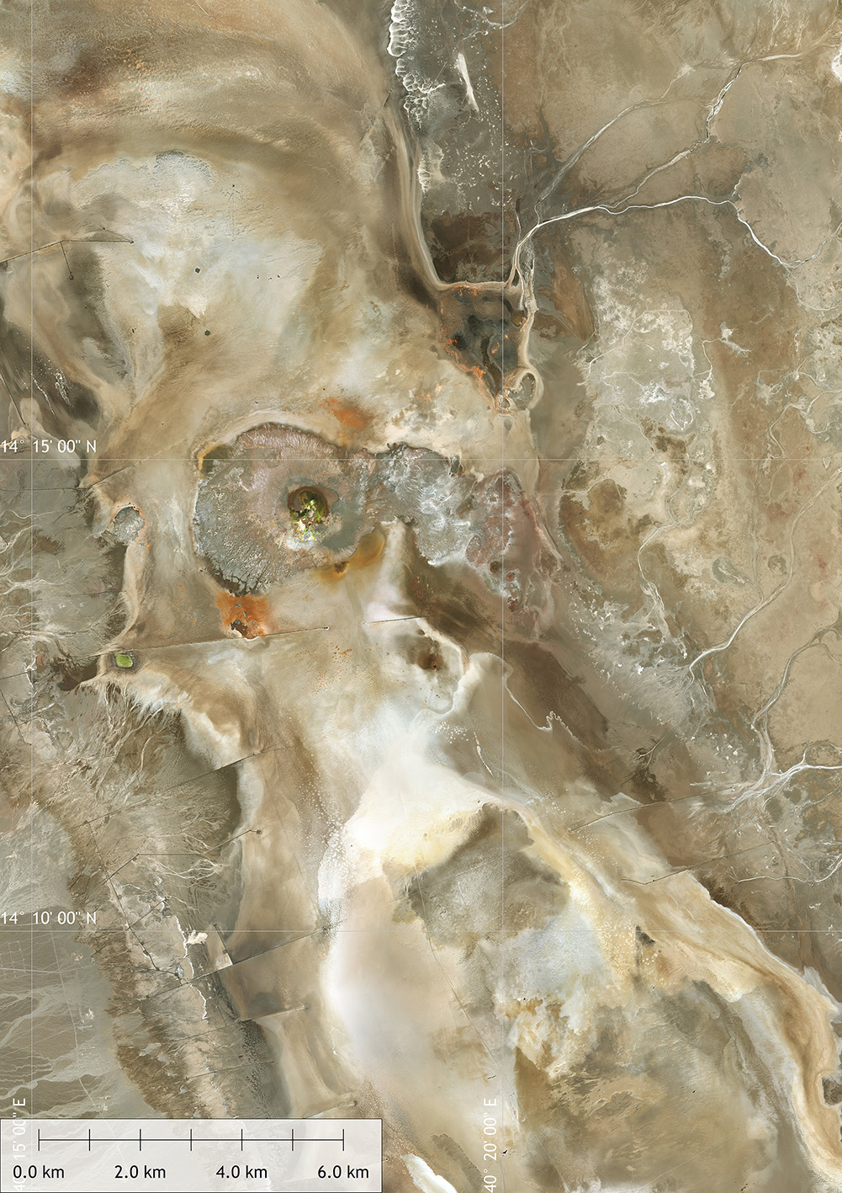
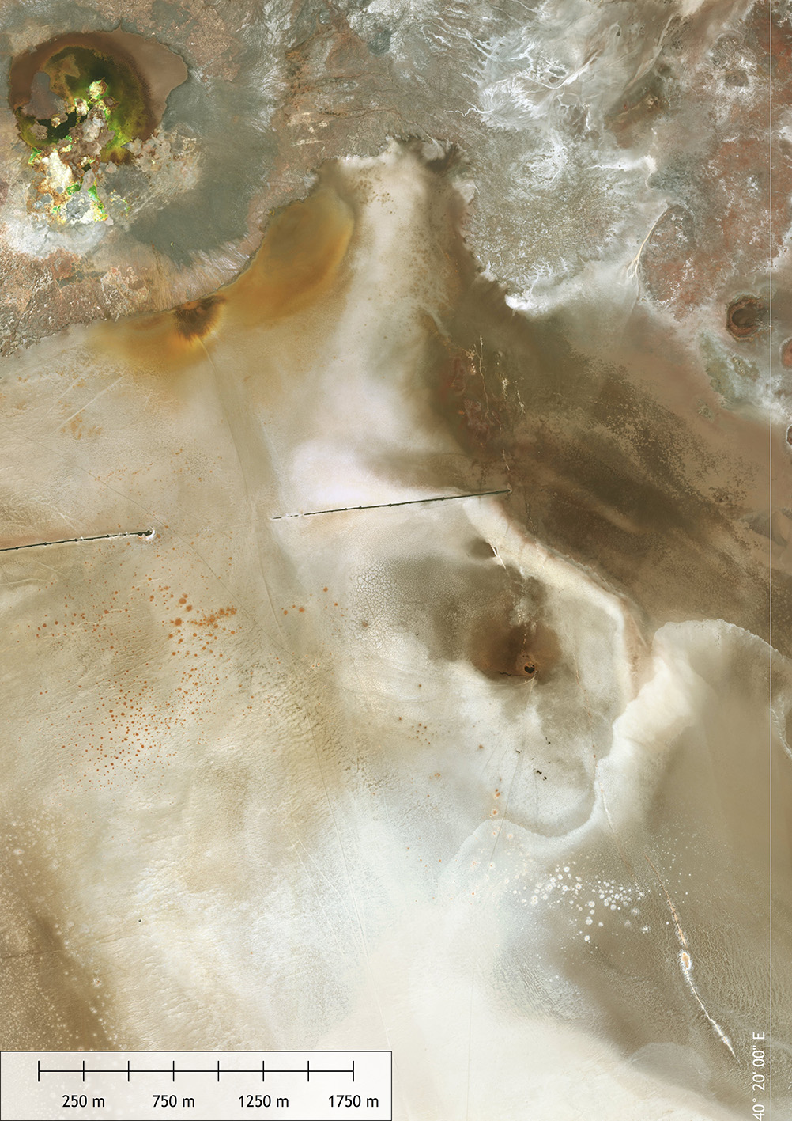
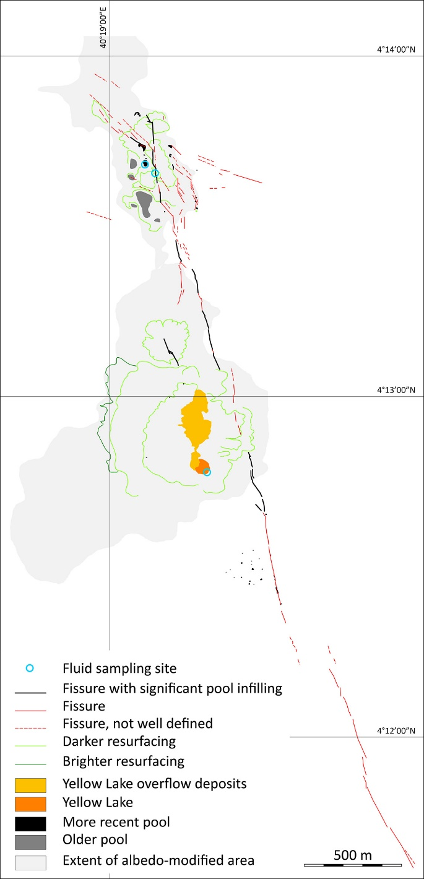

Yellow Lake Fissure

Slide 7
Yellow Lake fissure
1
NNW-SSE oriented
Meets NW-SE trend at its northerly end
7 main segments + 1 secondary fissure
Pools along some segments
Connected with the Yellow Lake
2
3
8
4
5
6
7

Slide 8
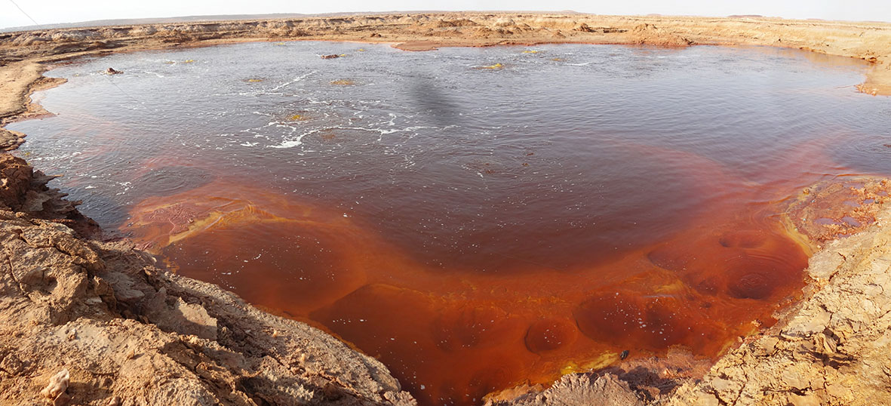
Yellow Lake fissure
Yellow Lake (Oily Lake/Gaet’ale)
Total dissolved solids of 433 g/kg in 2014 (Perez and Chebude 2017)
Higher salinity in 2018, see Moors and de Craen (EPSC, later today)
Episodic CO₂ emission bursts (Master 2016)

Slide 9
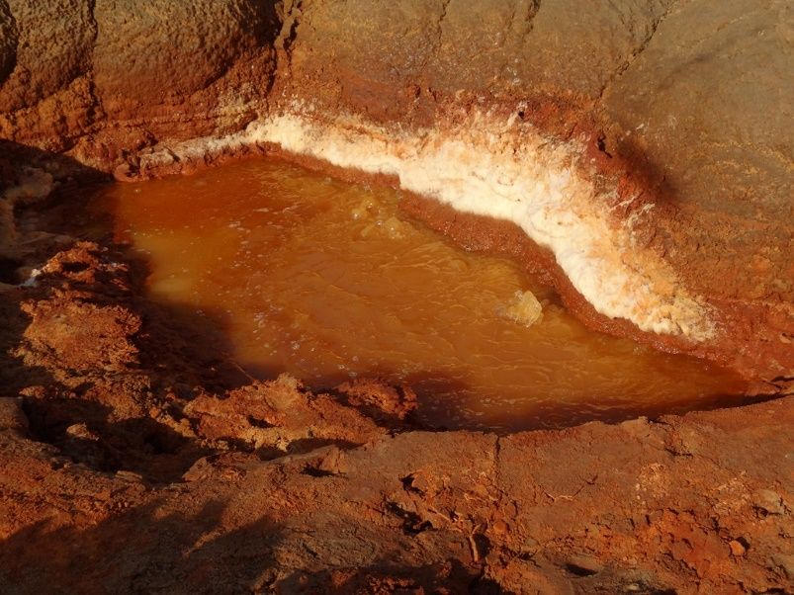
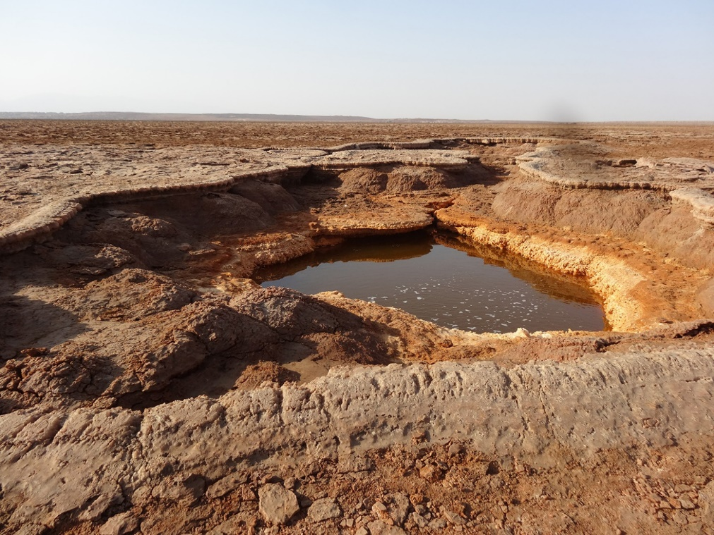
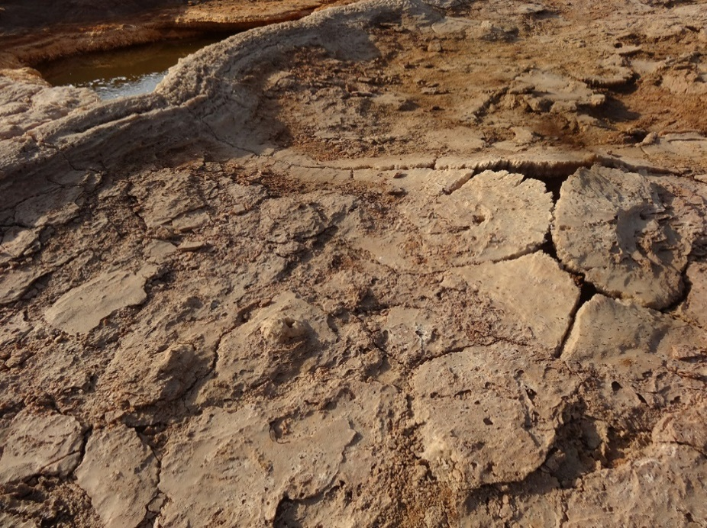
Yellow Lake fissure
Yellow Lake: Structural control
Two main pools
aligned with the main fissure trend
Secondary (bubbling) pool
Secondary fracture

Slide 10
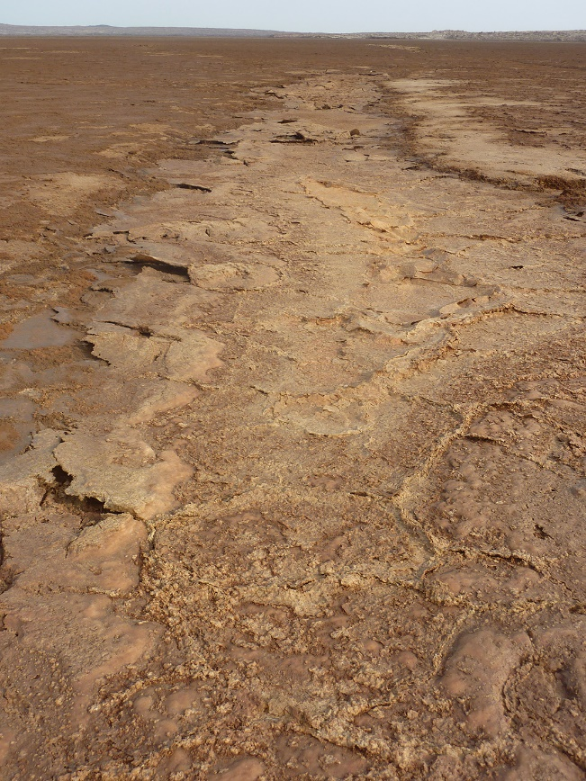
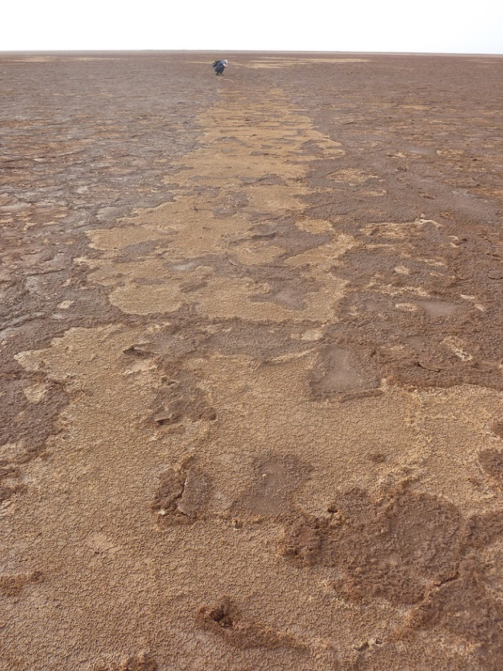
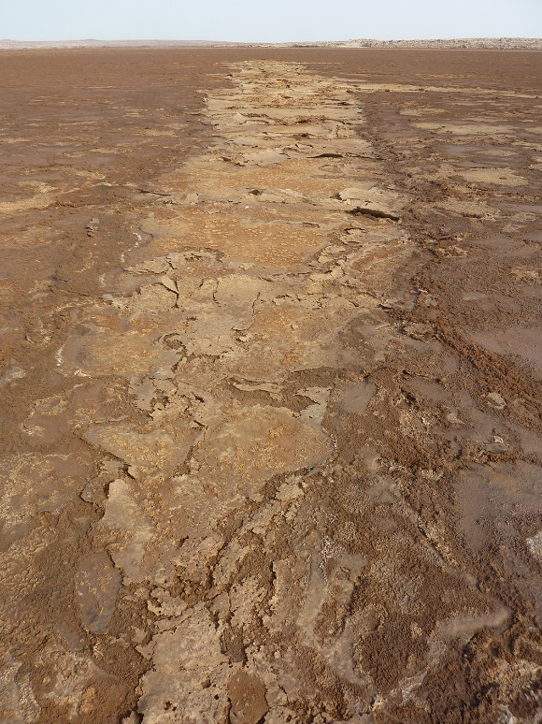
Yellow Lake fissure
Northerly segments: overview
Dallol
Remote segments

Slide 11
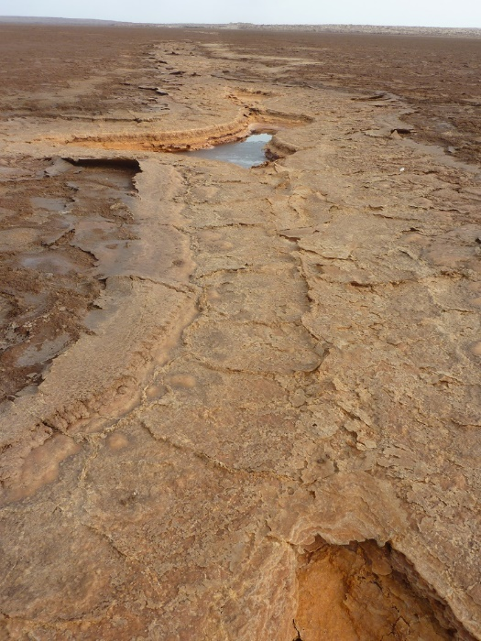
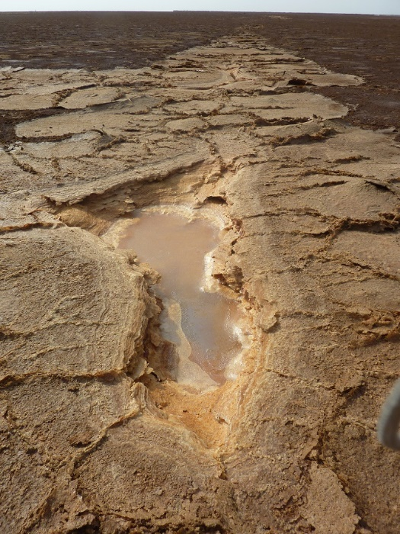
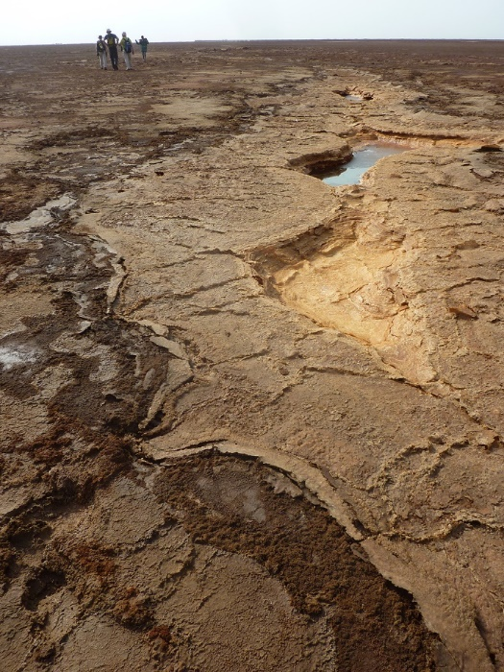
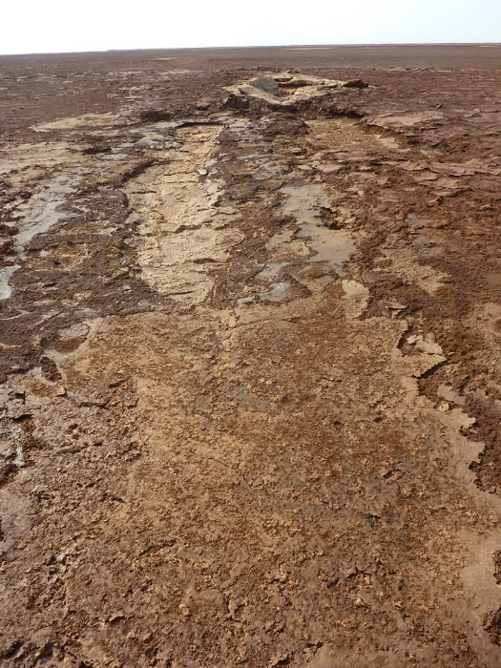
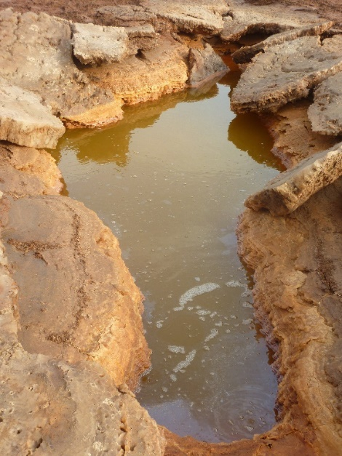
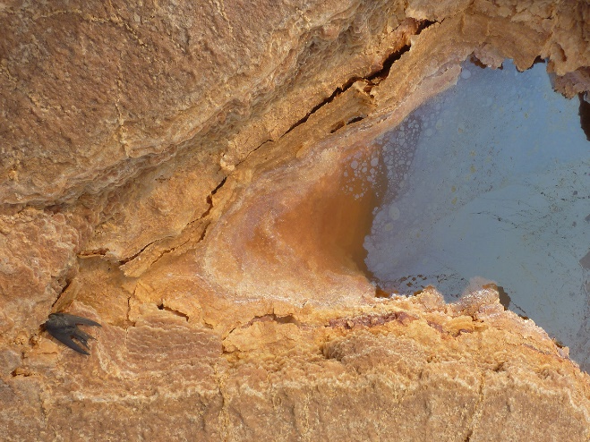
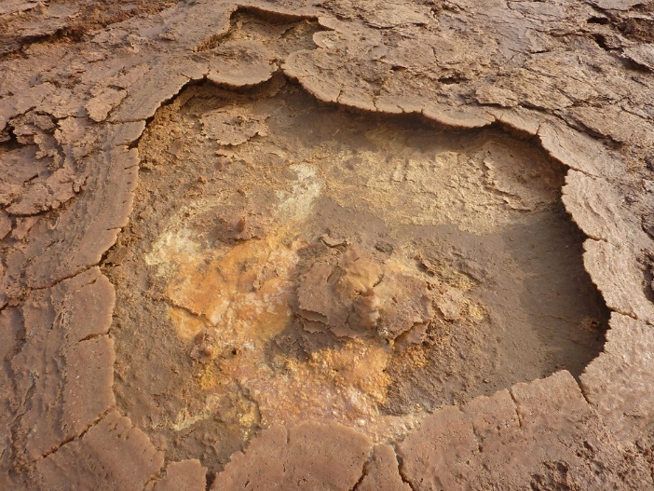
Yellow Lake fissure
Northerly segments: associated pools
CO₂ effect
Late-stage
concretion
Upwelling

Slide 12
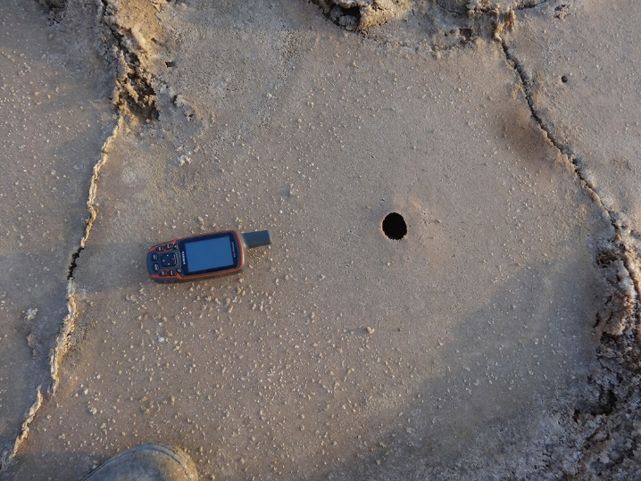
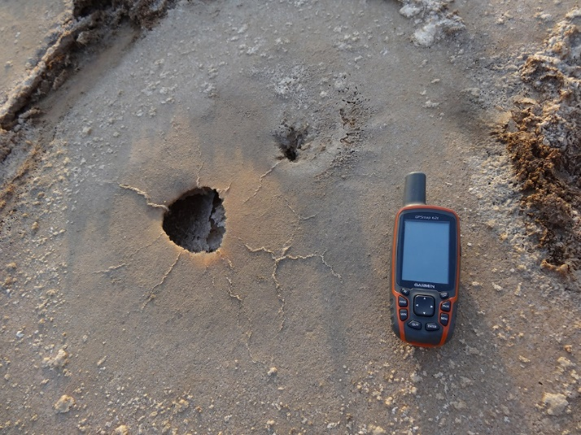
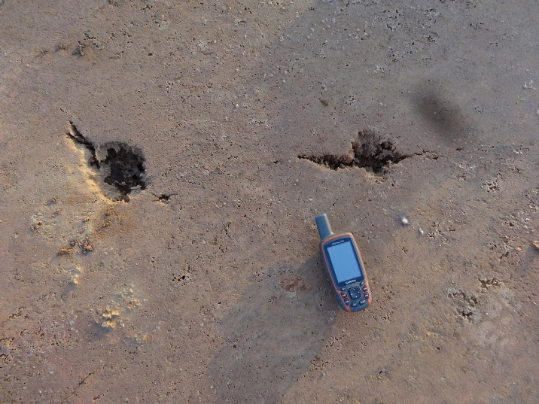
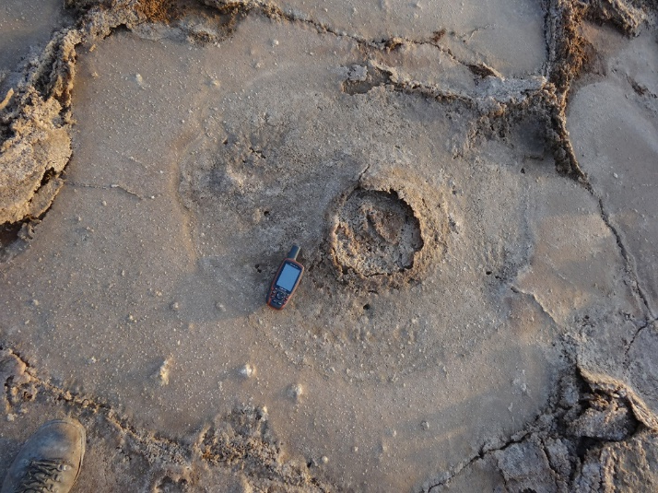
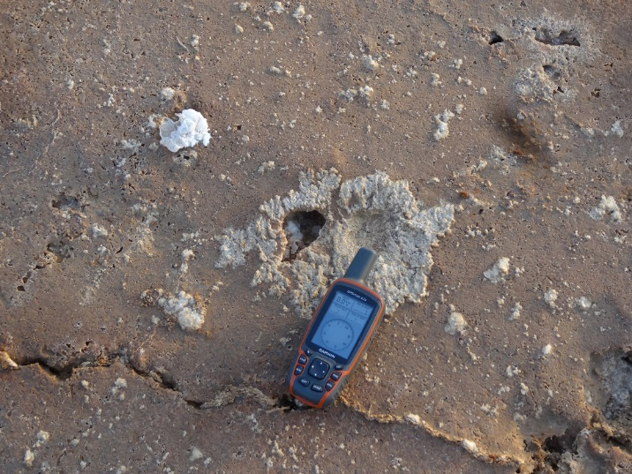
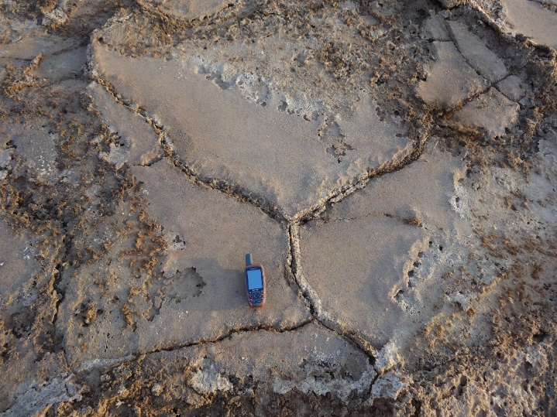
Yellow Lake fissure
Hydrothermal effects on salt plates
Hole with mineral deposition halo
Hole with halo and radial compression fractures
Hole (flaw) with fracture nucleation
Hole with liquified sediment surge deposits
Crater with recrystallised halo
Perforated plate and plate edge recrystallisation

Slide 13
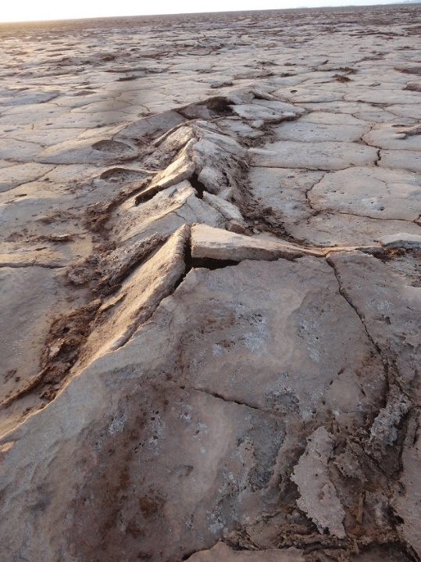
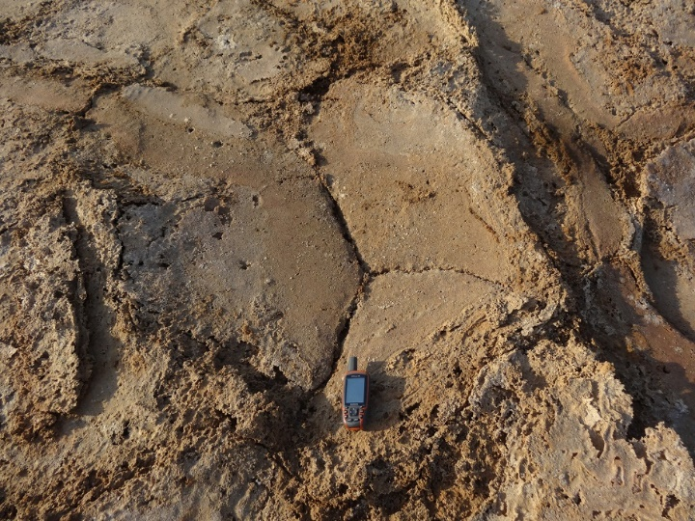
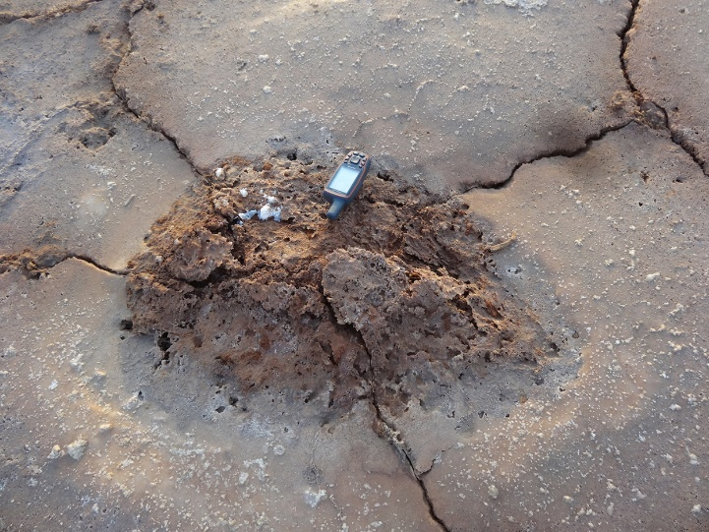
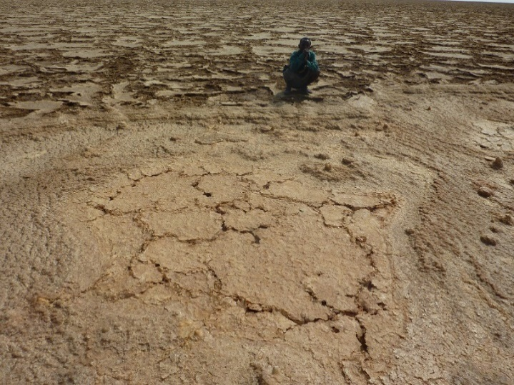
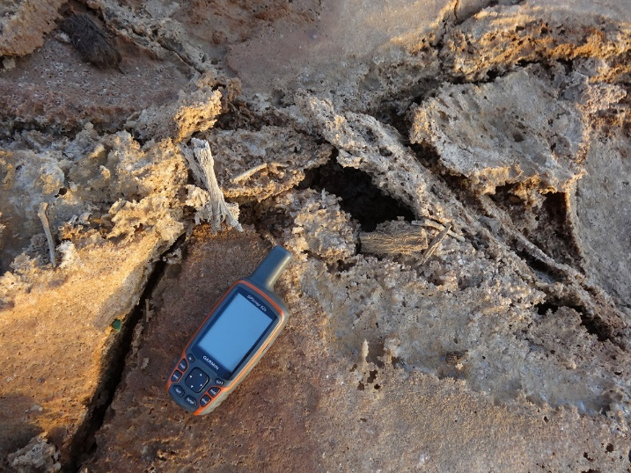
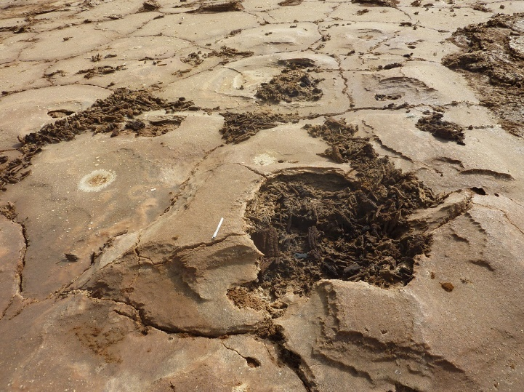
Yellow Lake fissure
Hydrothermal effects on salt plates
Uplifted fractured plates
Triple junction
Mud diapir
Polygon (above main fissure)
Vegetation salination
Burnt (?) vegetation in hole/crater

Slide 14
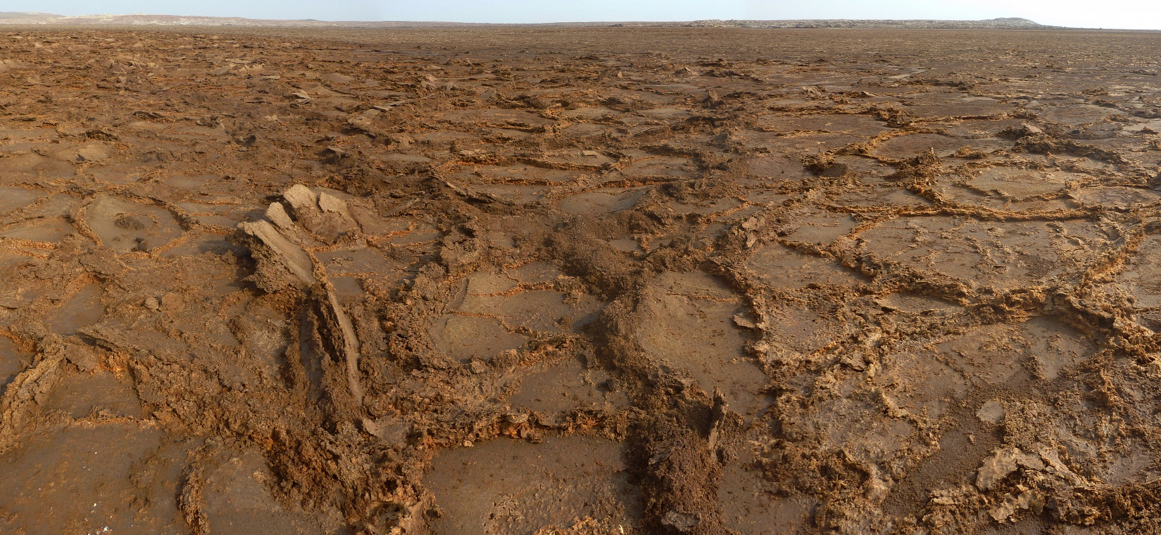
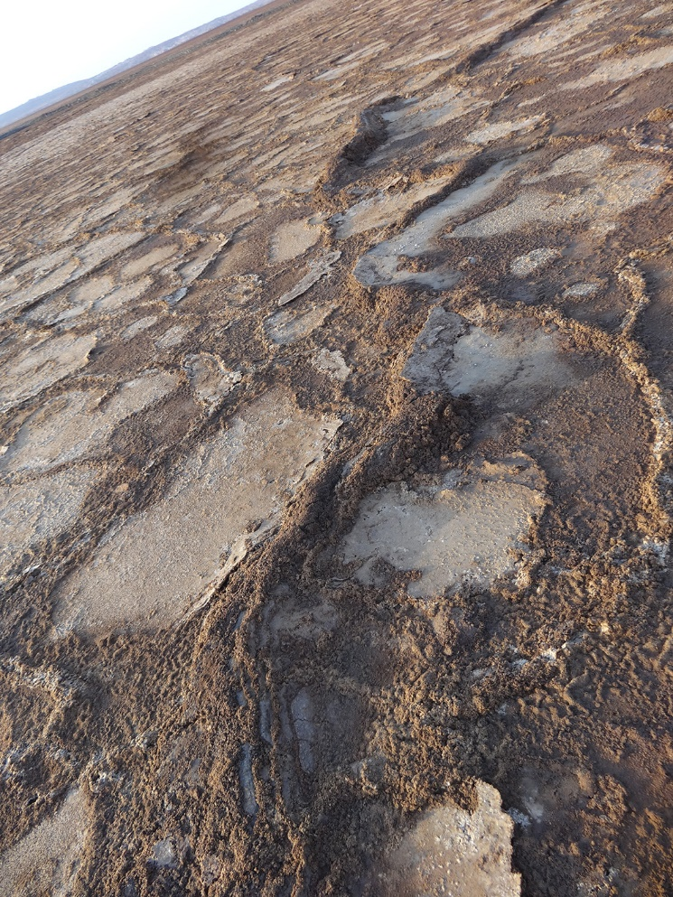
Yellow Lake fissure
Hydrothermal effects on salt plates
Clay ridges

Slide 15
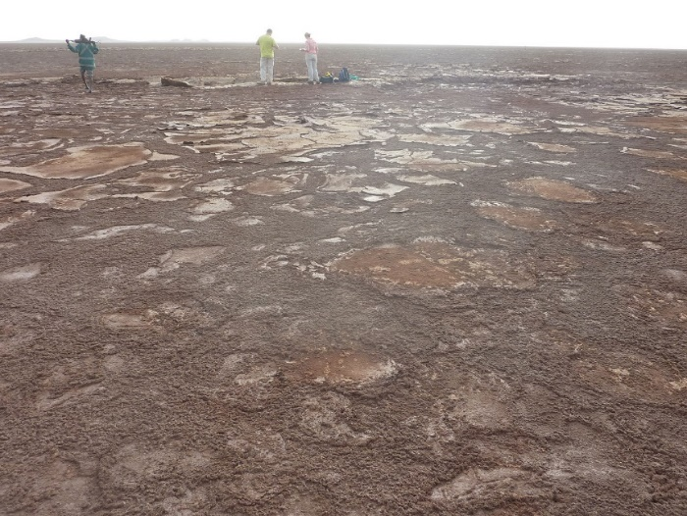
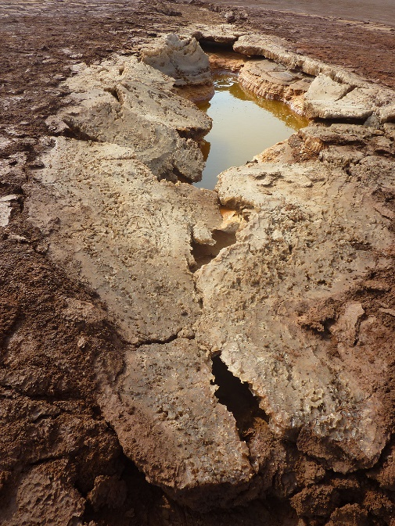
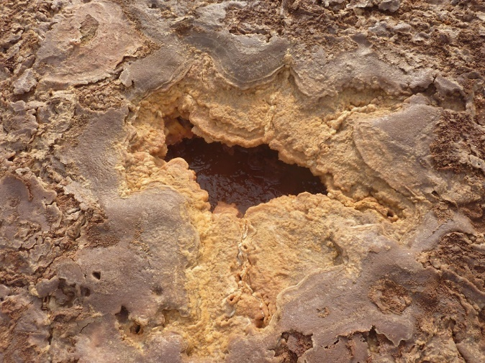
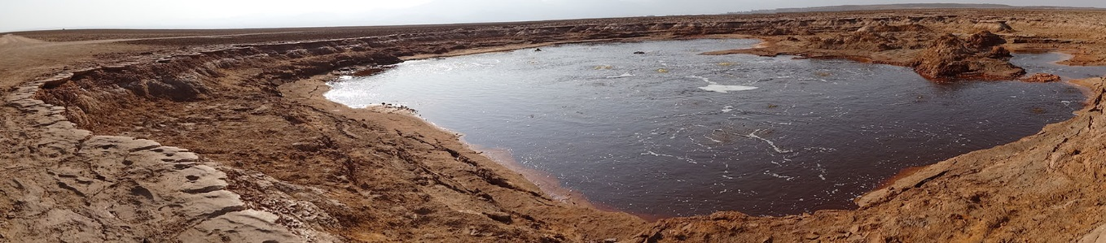
Yellow Lake fissure fluids
Hydrothermal fluids and minerals
 | Yellow Pool | Red Pool | Yellow Lake
T (°C) | 32.0 | 35.1 | 41.2
pH | 3.7 | 3.5 | 3.4
Conductivity | 395 | 494 | 598
Minerals | Halite Tachyhydrite | Sylvite Carnalite | Halite, Sylvite Tachyhydrite Chloromagnesite Artinite
Dominant cations | Ca²⁺>Na⁺>Mg²⁺>K⁺ | Ca²⁺>Mg²⁺> K⁺>Na⁺ | Ca²⁺>Mg²⁺>Na⁺>K⁺
Red Pool
Yellow Pool
pH and conductivity (mS.cm⁻¹) measured in lab at 25°C
Yellow Pool
Red Pool
Fluids have distinct composition, probably reflecting different local composition of sediments underneath
Yellow Lake
Yellow Lake

Slide 16
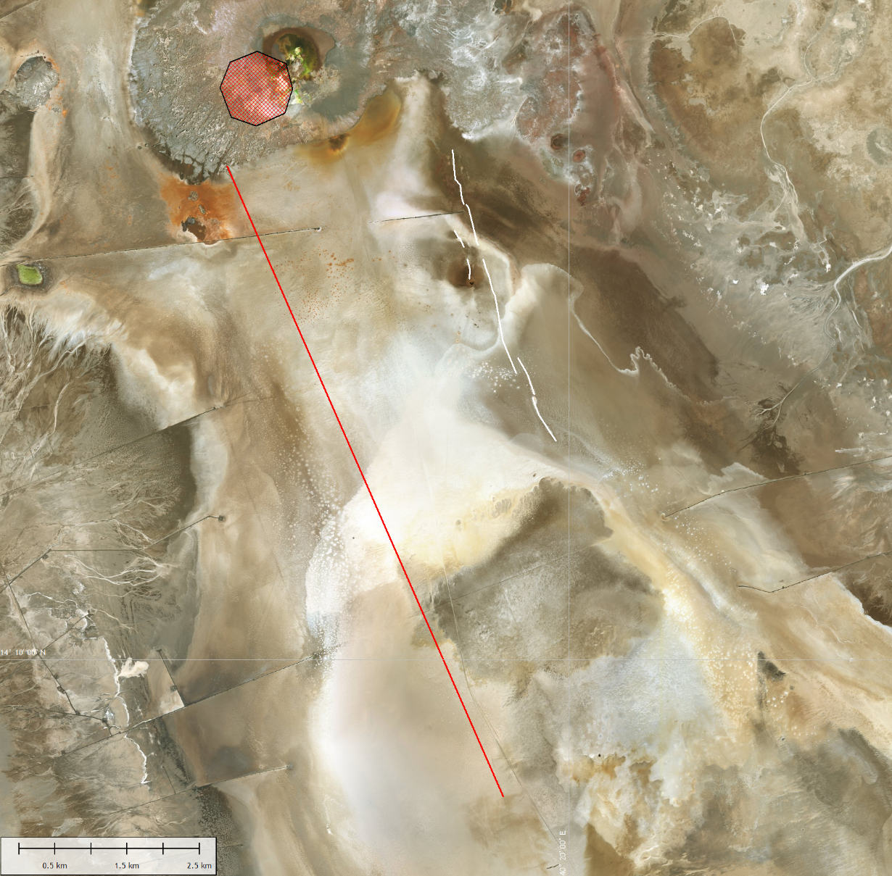
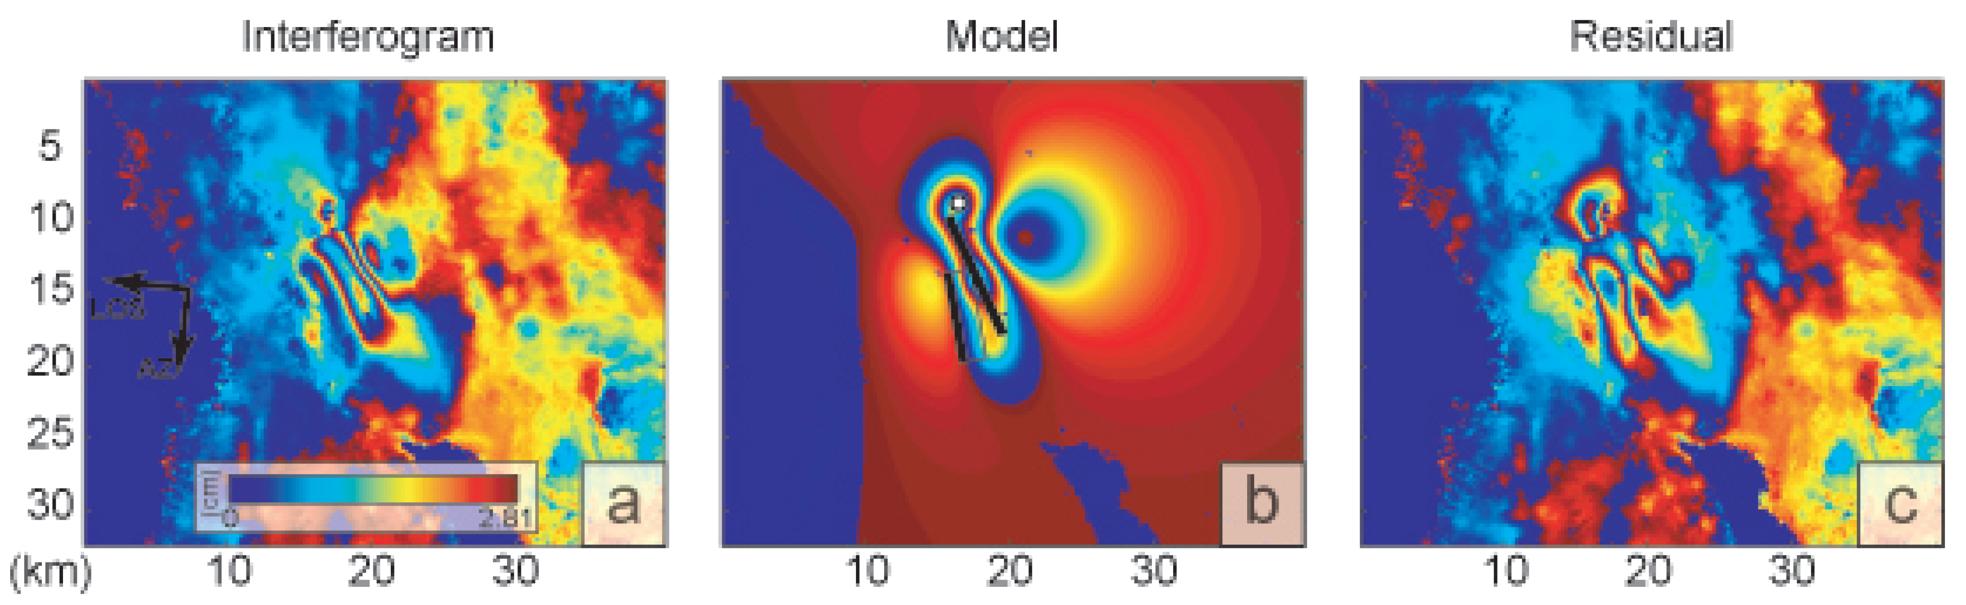
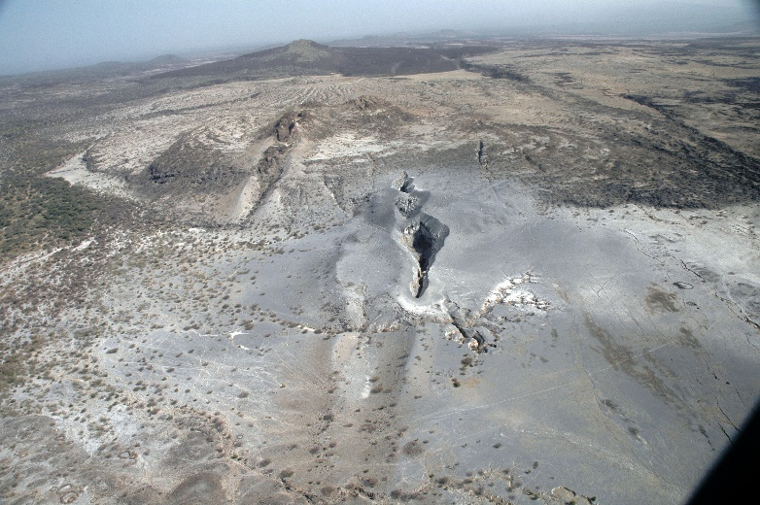
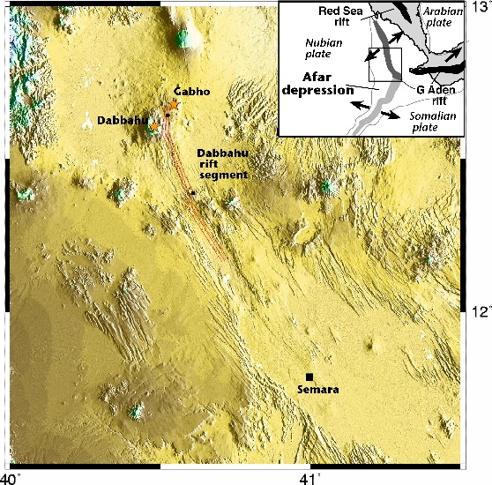
Other recorded events
2004
magma
injection centre
Dyke intrusion next to Black Mountain on 22 October 2004, followed by seismic fault slip between 27 October and 4 November 2 km away from the Yellow Lake fissure
Yellow Lake fissure
DANAKIL
MICROPLATE
Black
Mountain
NUBIAN
PLATE
No evidence for it found on the ground in January 2018.
Nobile et al. 2012
September 2005 Dabbahu rifting event 175 km away toward south
magmatic intrusion
Oct-Nov 2004
Nobile et al. 2012
Fault bottom
Fault top
photo by Asfawossen Asrat

Slide 17
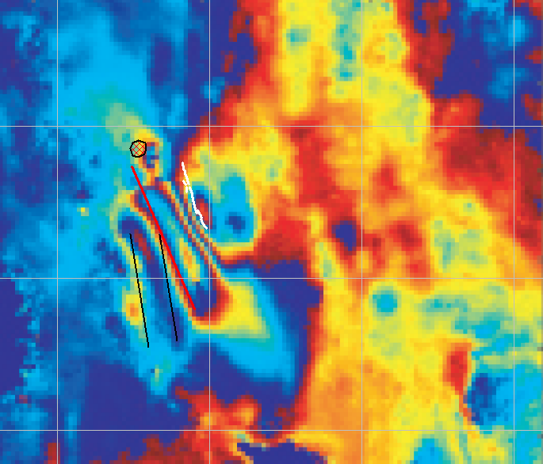

Age of the Yellow Lake fissure
Locals say that hydrothermal activity at Yellow Lake renewed following an earthquake in January 2005 (Master 2016).
Most seismicity associated to the 2004 intrusion and faulting event had ceased by November 4th, 2004 (Nobile et al. 2012).
Published interferograms however show that bulk ground deformation trend measured between October 27 and December 1st is consistent with the orientation of the Yellow Lake fissure.
Yellow Lake Fissure
after Nobile et al. 2012
Ground deformation
October 27 - December 1st

Slide 18
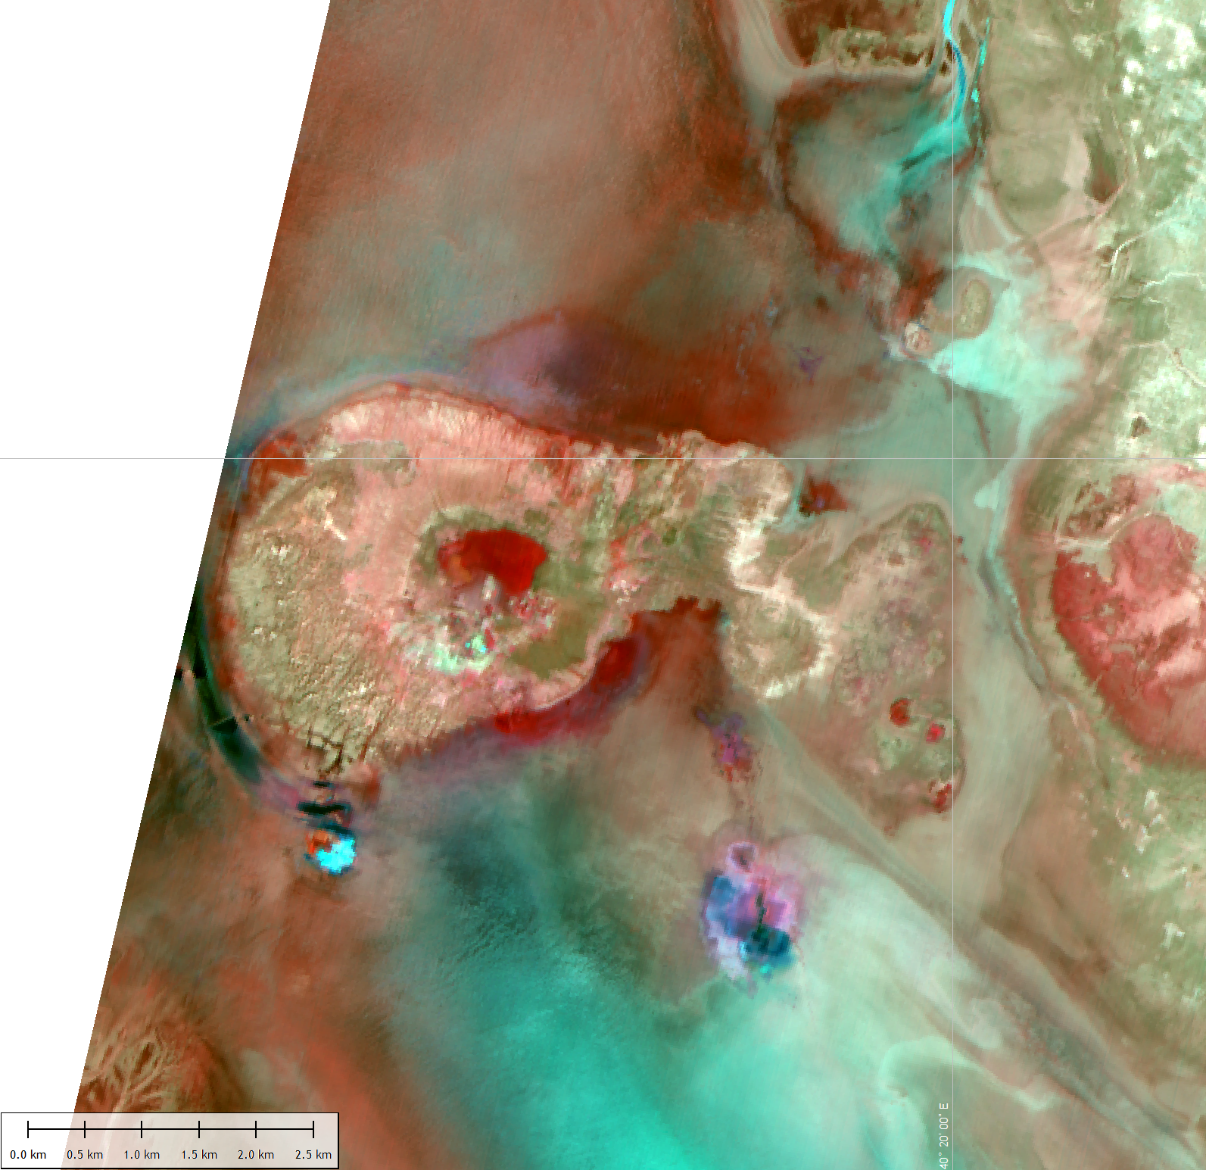












Age of the Yellow Lake fissure
Are satellite data consistent with a January 2005 fissure age?
08-02-2006
Spot-4 (10m)
OrbView-3 (1m)
Landsat-8 (b8 – 10 m)
ASTER (b3N-b2-b1 – 15 m)
17-12-2005
17-11-2005
-- DABBAHU ERUPTION
10-06-2005
23-04-2005
04-04-2005
18-02-2005
02-02-2005
01-01-2005
14-11-2004
-- BLACK MTN DYKE
30-12-2003
12-01-2003

Slide 19

Age of the Yellow Lake fissure
Locals say that hydrothermal activity at Yellow Lake renewed following an earthquake in January 2015 (Master 2016).
Most seismicity associated to the 2004 intrusion and faulting event had ceased by November 4th, 2004 (Nobile et al. 2012).
Published interferograms however show that bulk ground deformation trend measured between October 27 and December 1st is consistent with the orientation of the Yellow Lake fissure.
Satellite imagery confirms that hydrothermal activity indeed increased in February 2005. The fissure itself formed between April 4th and June 10th, 2005.

Slide 20


Evolution since fissure formation
Today
17-12-2005

Slide 21


Evolution since fissure formation
20-11-2016
17-12-2005
North

Slide 22


Evolution since fissure formation
20-11-2016
17-12-2005
middle

Slide 23


Evolution since fissure formation
20-11-2016
17-12-2005
South
No clear evidence of renewed tectonic activity
Hydrothermal activity is still vigorous, with effects now extending outside the fissure area
Fracture segment geometry is rather well preserved (maintained?) after 11 years

Slide 24





Subsurface structure
Data from potash mining companies
Magnetic survey by Ralph M. Parson’s Company: 3 magnetic highs
Black Mountain
Skating Rink
The source of the magnetic anomaly at Mount Dallol provides a plausible origin for the YLF hydrothermal activity.
Dallol crater
after Holwerda and Hutchinson 1968

Slide 25
Summary
An active fissure has been identified in the Danakil rift between the Erta'ale Range and Mount Dallol.
It developed between April and June 2005 after a 2-4 months period of increased hydrothermal activity.
Of the features that formed in response to the 3 events of the tectonic-magmatic crisis of 2004-2005, this fissure may be the only one still active. Hydrothermal activity seems to be gradually spreading to a rock volume larger than the hydrothermal fissure immediate vicinity.
The fluids are probably primarily controlled by a magmatic source, but the diversity of hydrothermal fluids indicate significant compositional control by the local sedimentary sequence, reflecting the fluid path between the magma and surface.
Geo-microbiological study of these fluids will be presented in a moment.
The magma source is deeper than 1 km, perhaps as deep as 2-3 km if directly connected to the 2004 event, in which case the YLF would also be related to the intrusion underneath Mount Dallol.
Ground magnetic survey is planned in January 2019 within the framework of the next Europlanet TA Danakil campaign, in order to accurately determine geometry of shallow intrusions potentailly associated to the Yellow Lake fissure and areas of preferential sedimentary alteration, as well as locate the nearby Black Mountain dyke.
Terra SAR-X and Tandem-X topography data analysis is also planned.

Slide 26
Additional slides

Slide 27


Subsurface structure
Sedimentary and hydrogeological framework
Conceptual groundwater modelling
Sedimentary sequence
Anderson and Goode 2017
Rauche and van der Klauw 2015

Slide 28



Subsurface structure
YLF
Data from potash mining companies
Drillings
W
E
Seismic profiles
2004
magma
injection centre
ridge clays?
Yellow Lake
fissure
ALLANA POTASH data, after Rauche and van der Klauw 2013, 2015
Faults from seismics and 2004 event
Magmatic intrusion may be present beneath more than 1 km of sediments
magmatic intrusion
Oct-Nov 2004

Slide 29

Subsurface structure
Data from potash mining companies
YLF
Drillings
Seismic profiles
NW
SE
2004
magma
injection centre
Yellow Lake
fissure
YARA DALLOL data, Yara Dallol 2014
Faults from seismics and 2004 event
The sedimentary sequence is uplifted toward the edge of the Dallol mound
magmatic intrusion
Oct-Nov 2004

Slide 30

Subsurface structure
Interferometric modelling
Drillings
Seismic profiles
2004 Mogi source below Mount Dallol
is at depth ca. 2.4 km
2004
magma
injection centre
Yellow Lake
fissure
Faults from seismics and 2004 event
Nobile et al. 2012
magmatic intrusion
Oct-Nov 2004

