Slide 1



High-resolution ground magnetics survey in the Danakil depression
Why, what, how, and first results
Daniel Mège¹, Hanjin Choe², Jérôme Dyment ²
¹Space Research Centre, Warsaw, Poland
²Institut de Physique du Globe, Paris, France

Slide 2
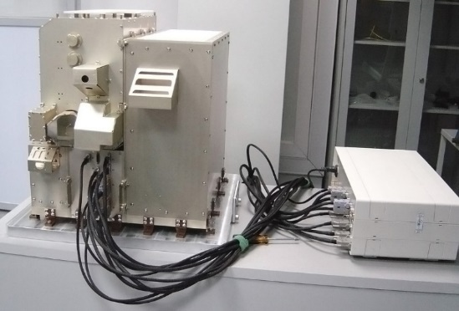
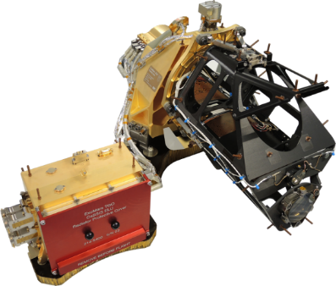
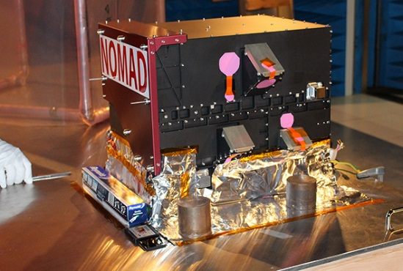
Why
Some of the past, and perhaps present, hydrothermal activity on Mars is related to volcanic fissures in "rift" zones.
Biological activity in such environment develop irrespective of climate conditions, it is rather controlled by local crustal and fluid properties, making comparison between their terrestrial and martian geoenvironments particularly relevant.
The Danakil rift is even more attractive as a terrestrial rift analogue because of the evaporitic environment.
Investigating the geomorphology and structure of the Danakil rift, correlated with the biological content of its hydrothermal sites, may therefore provide useful about environments on Mars prone to current and past biological activity to be expected.
Such environments may be detected by ExoMars TGO instruments.
ACS
CaSSIS
NOMAD

Slide 3
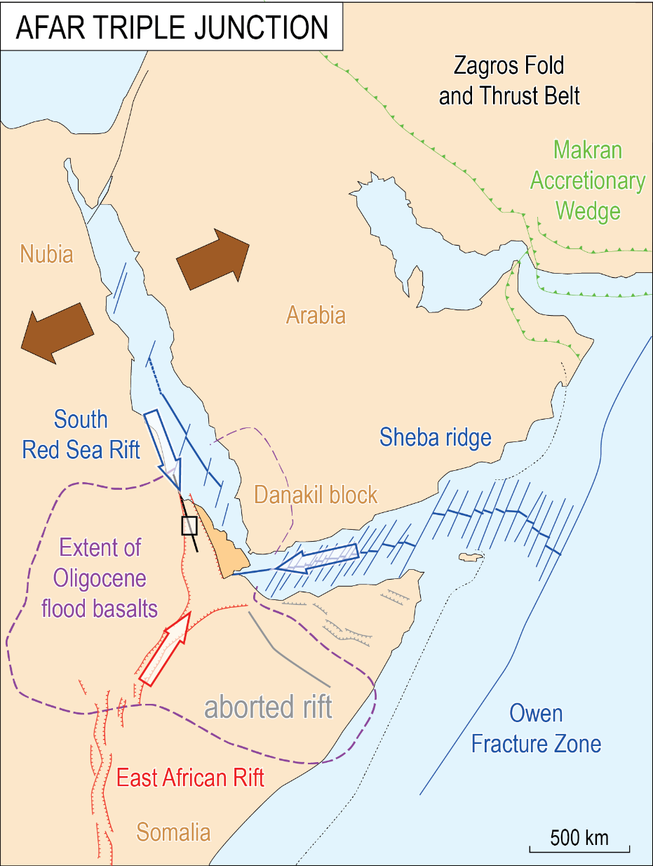
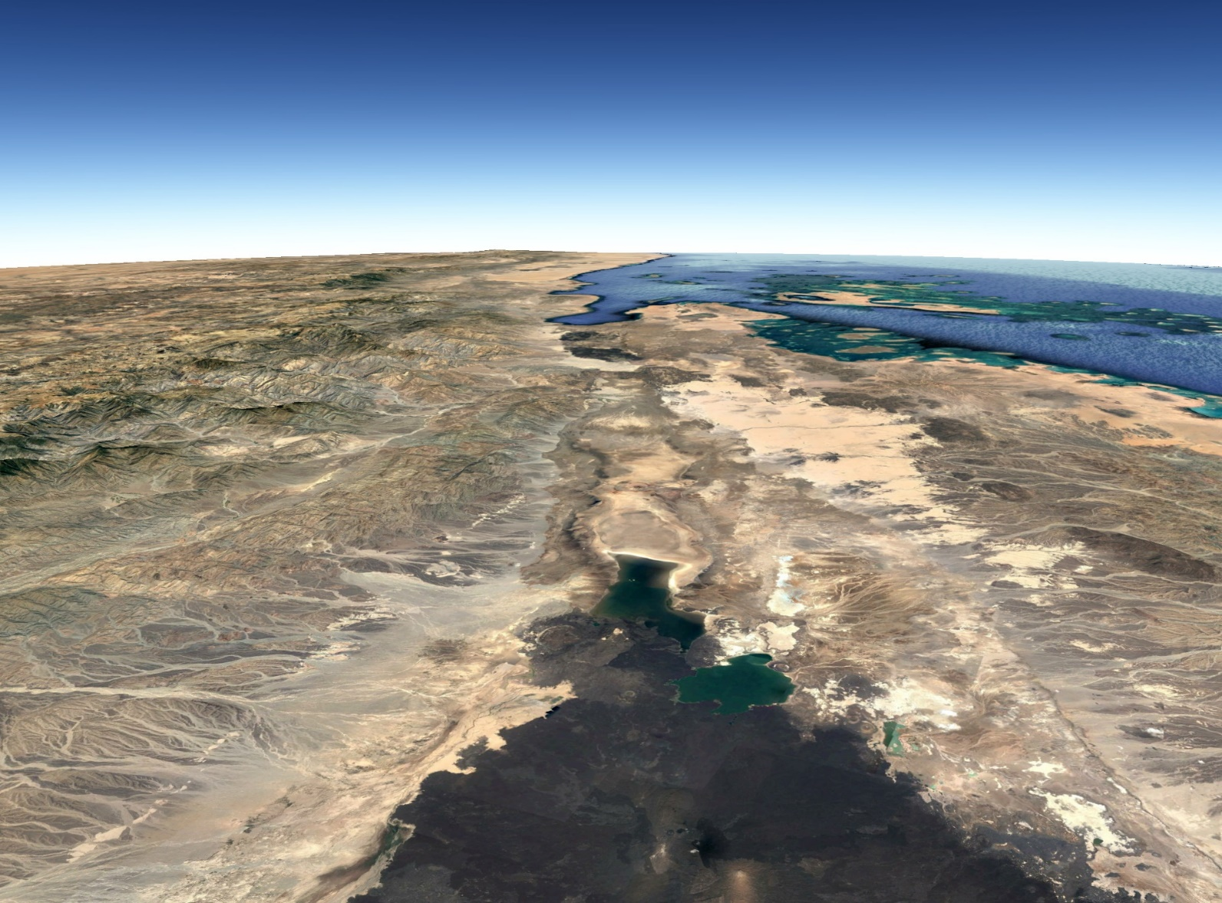
What
North
Gulf of Zula
Alid volcano
NUBIA
Dallol dome
DANAKIL BLOCK
Lake Karum (Asale)
Erta’ale
after Mège et al. 2015

Slide 4
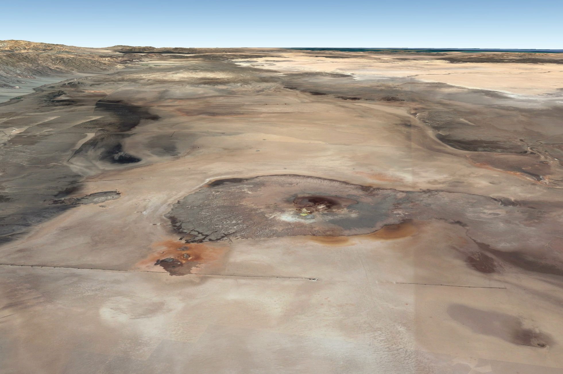
What
North
Dyke injection centre
Depth 2.4 km
Dallol dome (-80 m)
Danakil depression (-120 m)
Volcanic dyke
Depth 1-7 km
(Nobile et al. 2012)
Hydrothermal fissure formed in 2005
(Europlanet field campaign 2018,
Mège, Hauber, Moors, de Craen, 2018 EPSC)

Slide 5
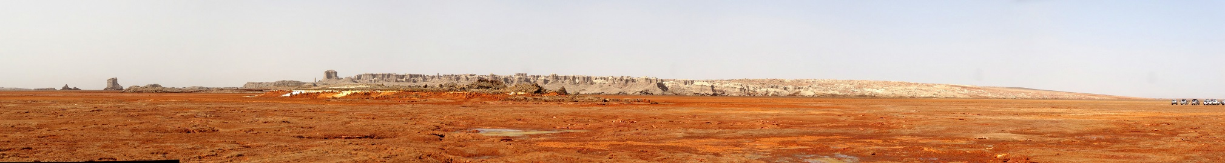
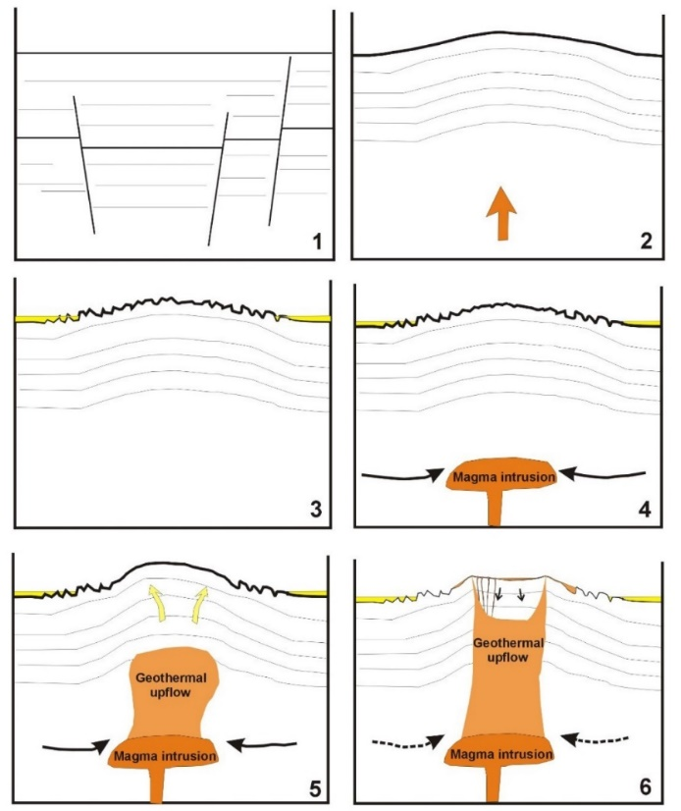
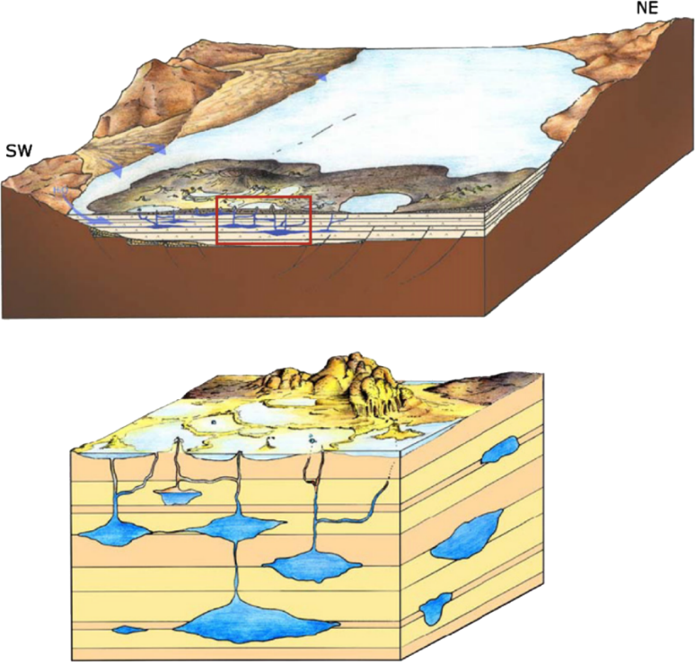
The Dallol hydrothermal system
Evaporite deposits
(1000 m or more)
Carniel et al. 2010
Franzson et al 2015

Slide 6
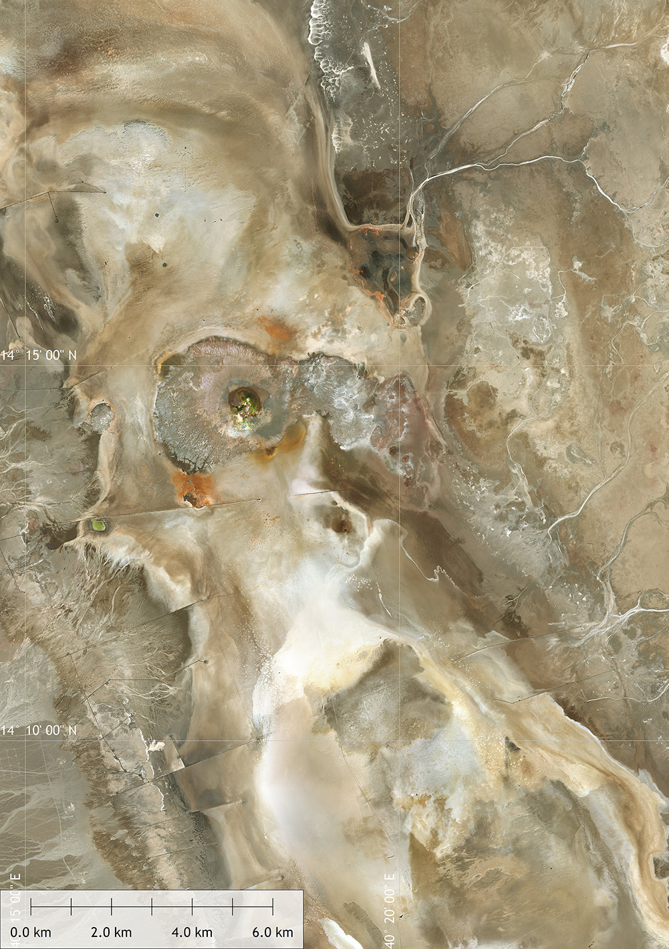
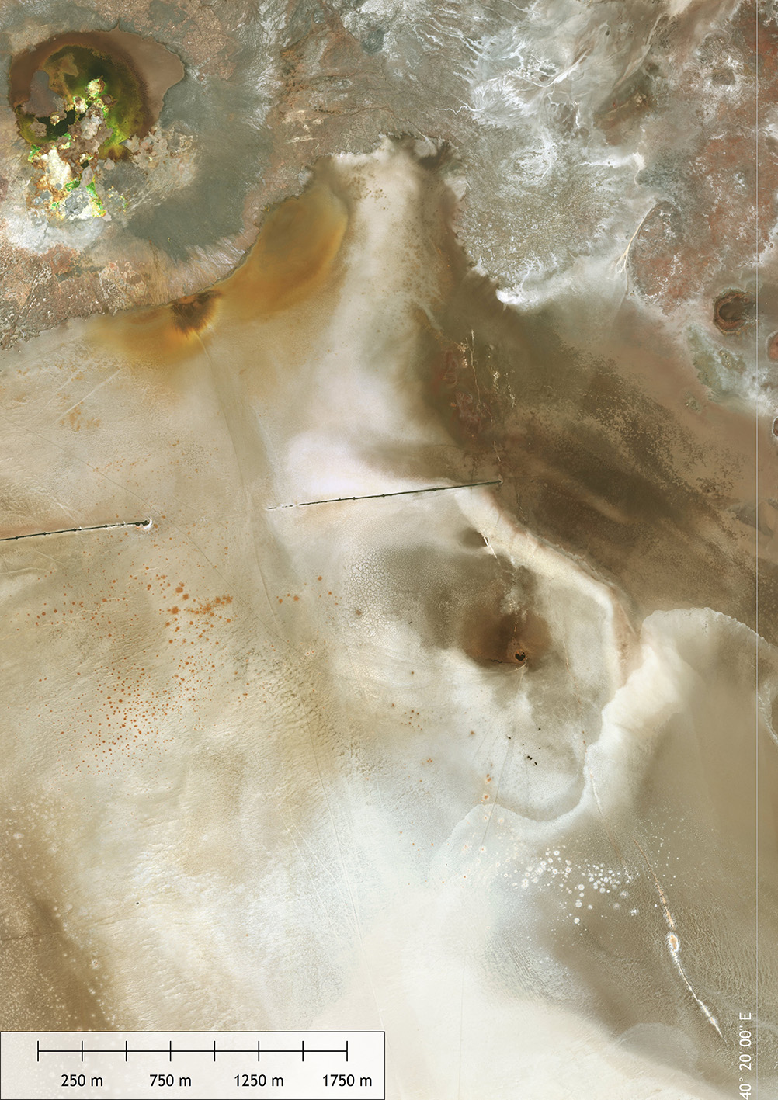
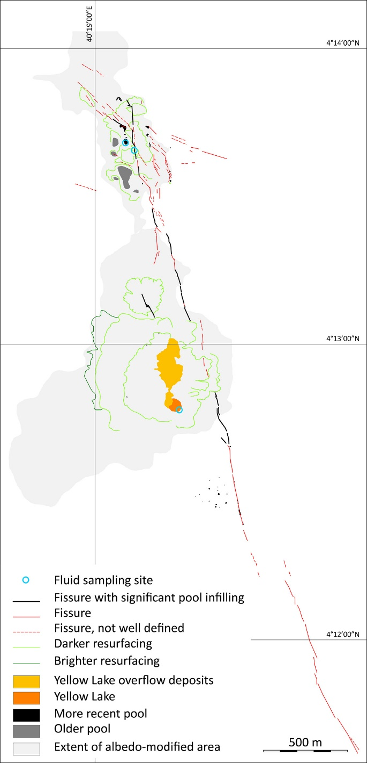

Previous work: Yellow Lake Fissure mapped in 2018

Slide 7
Objectives of 2019
Determine the nature of the Yellow Lake Fissure
Why not characterise the 2004 volcanic dyke as well?

Slide 8
How
In this work we are attempting to characterise hydrothermal and magmatic in the Danakil rift in the Dallol area using very high frequency ground magnetics
This dataset will complement existing geophysical data obtained by potash mining companies.
Cooperation agreement with Yara Dallol B.V.
  makes access to some areas easier
  makes possible installation of a permanent magnetic station for continuous diurnal measurement of magnetic background throughout the 2-week survey
  includes joint interpretation of data, consistent with and constrained by geophysical data independently obtained by Yara Dallol.

Slide 9
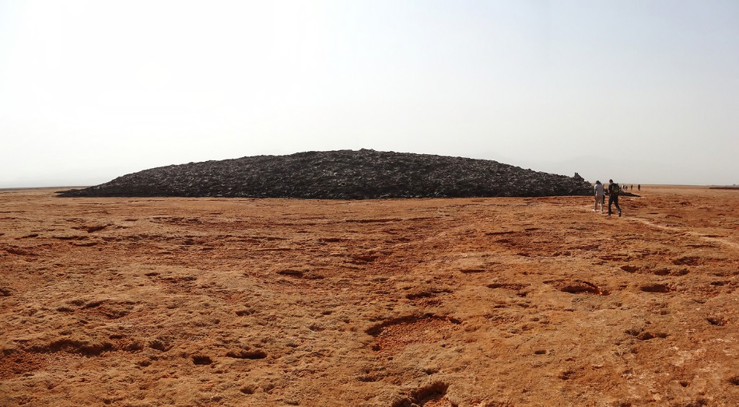
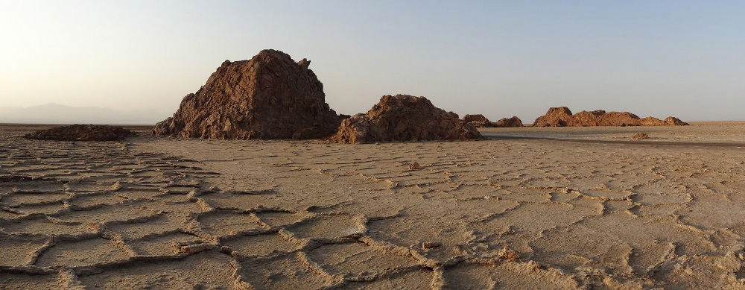
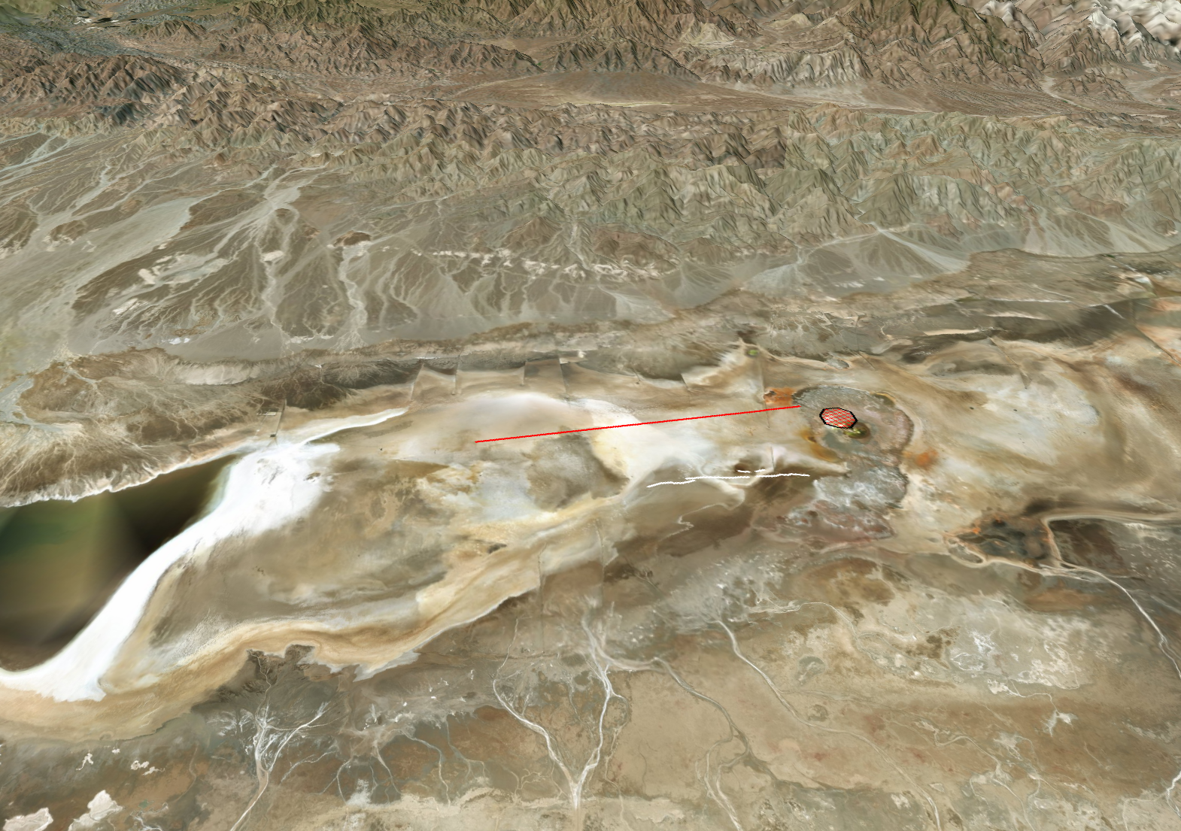
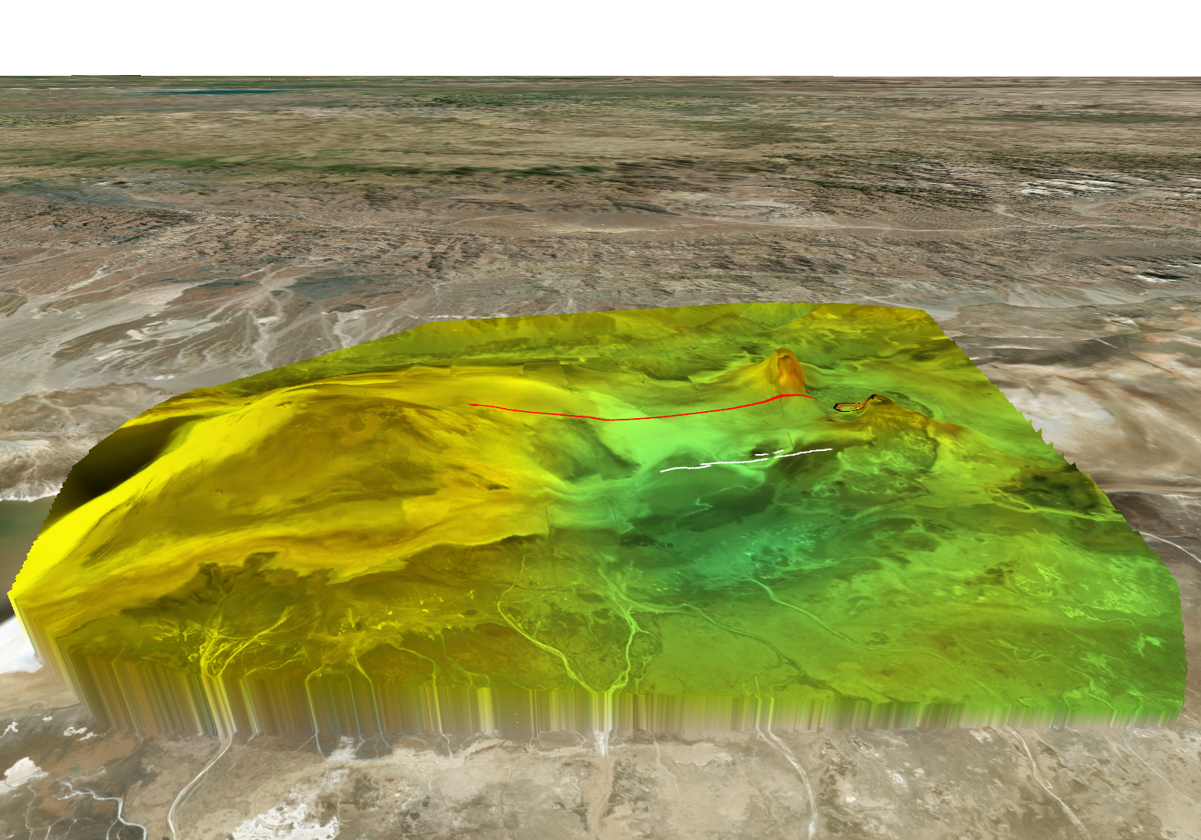
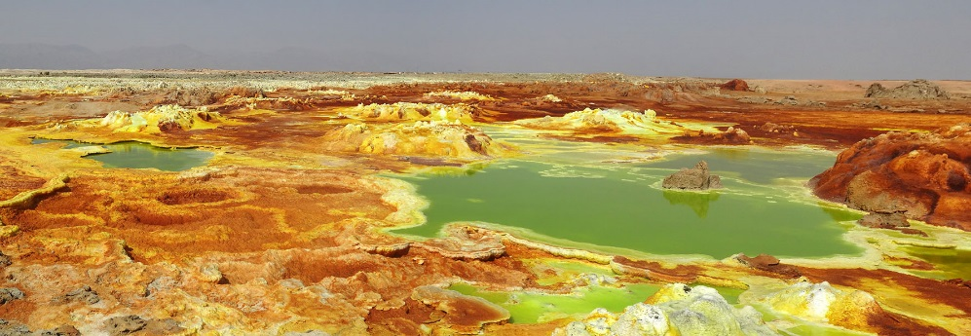
Danakil airborne magnetic survey by Parsons Corp. (60's)
Black Mountain
Skating Rink
(Asale Mtn)
The source of the magnetic anomaly at Mount Dallol provides a plausible origin for the YLF hydrothermal activity.
Mount Dallol
after Holwerda and Hutchinson 1968

Slide 10
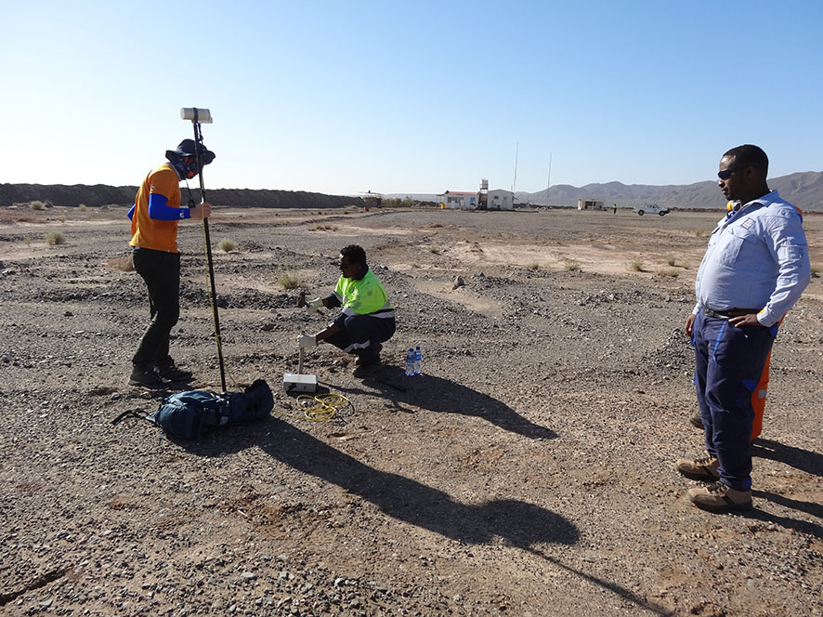
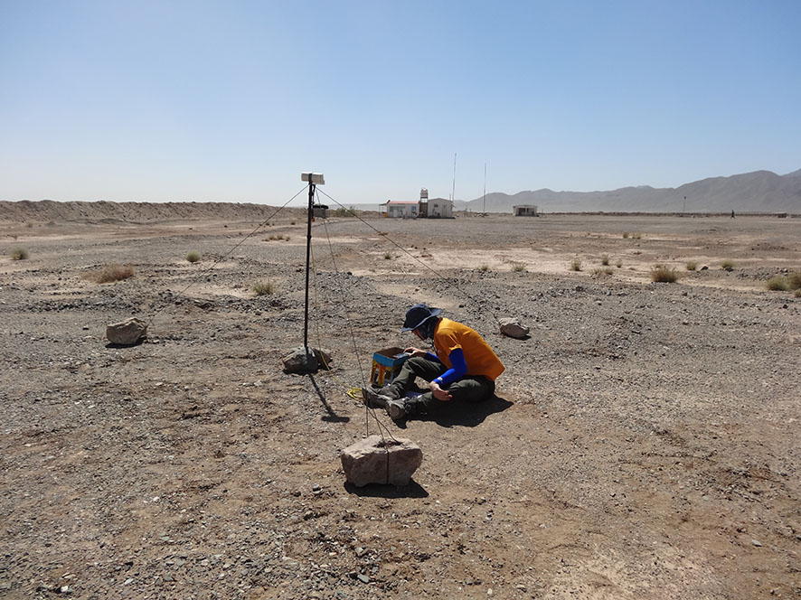
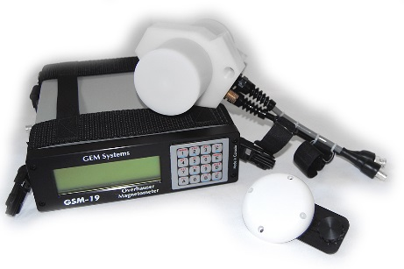
Measurement of background magnetic field
Ambient magnetic field was continuously measured during the survey at Yara Dallol camp, located 5.5 km west of Mount Dallol
Overhauser Magnetometer GemSystems GSM-19, precision 0.01 nT
S/N ratio was maximum throughout the survey

Slide 11
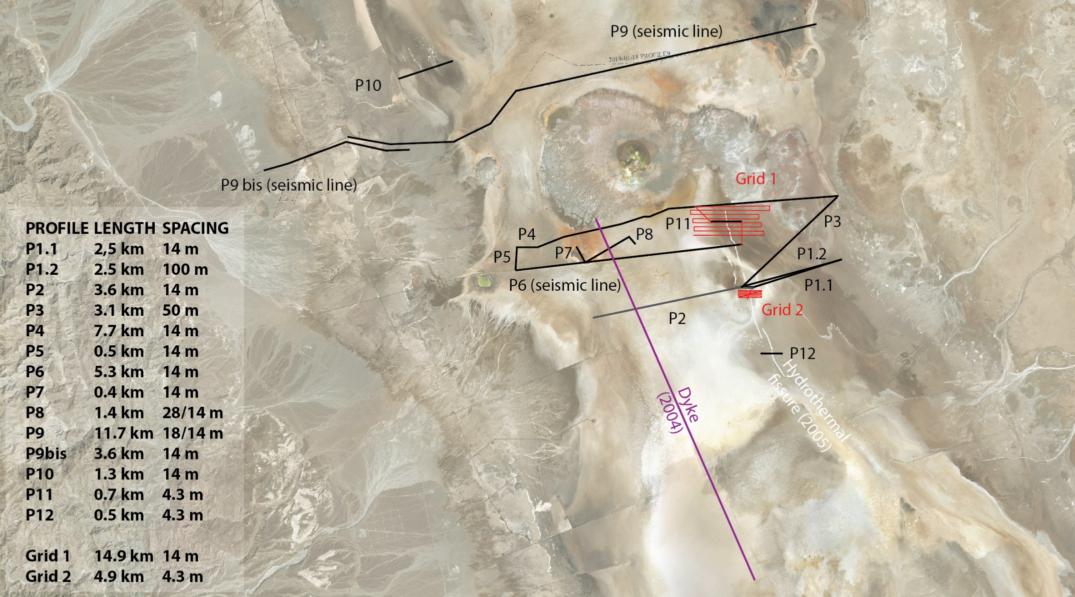
Profile measurements
Similar magnetometer
S/N ratio was maximum throughout the survey
Long profiles to characterise long wavelength signal (basement) and correlation with seismic data
Intermediate size profiles to characterise diffuse flows in hydrothermal areas
Tight grids and short very high resolution profiles to characterise small features
Total surveyed profile length: 64.6 km

Slide 12
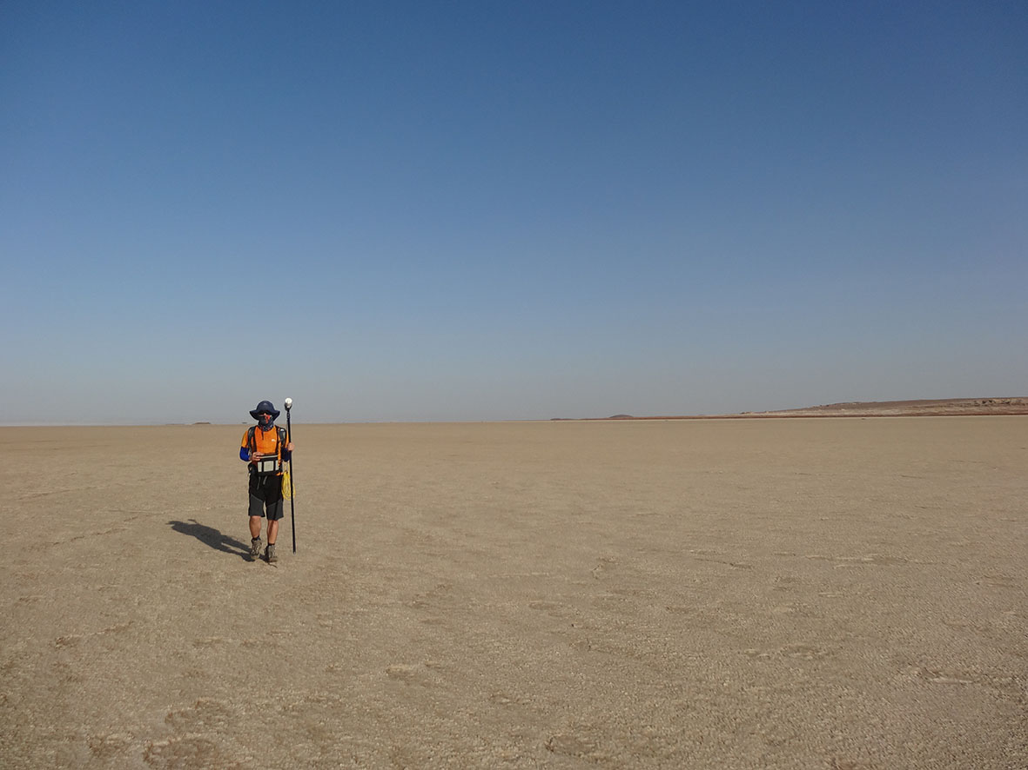
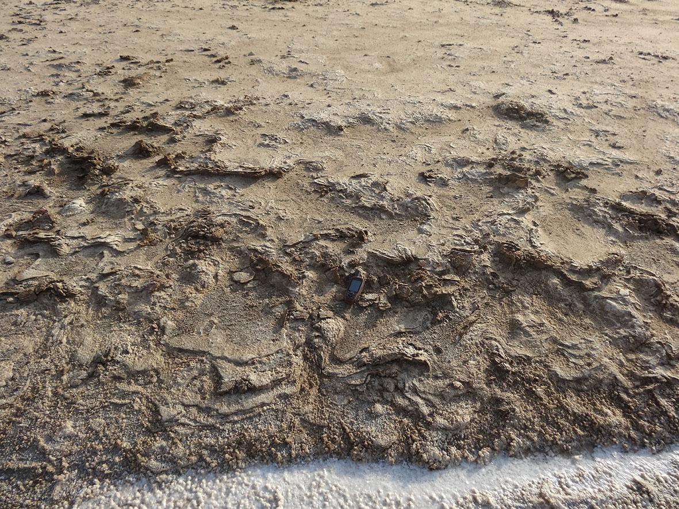
Portfolio
P9 (seismic line)
20 steps, 1 measurement
P9bis (seismic line)
Small-scale gravitational instabilities
are responsible for very short wavelength
magnetic field anomalies

Slide 13
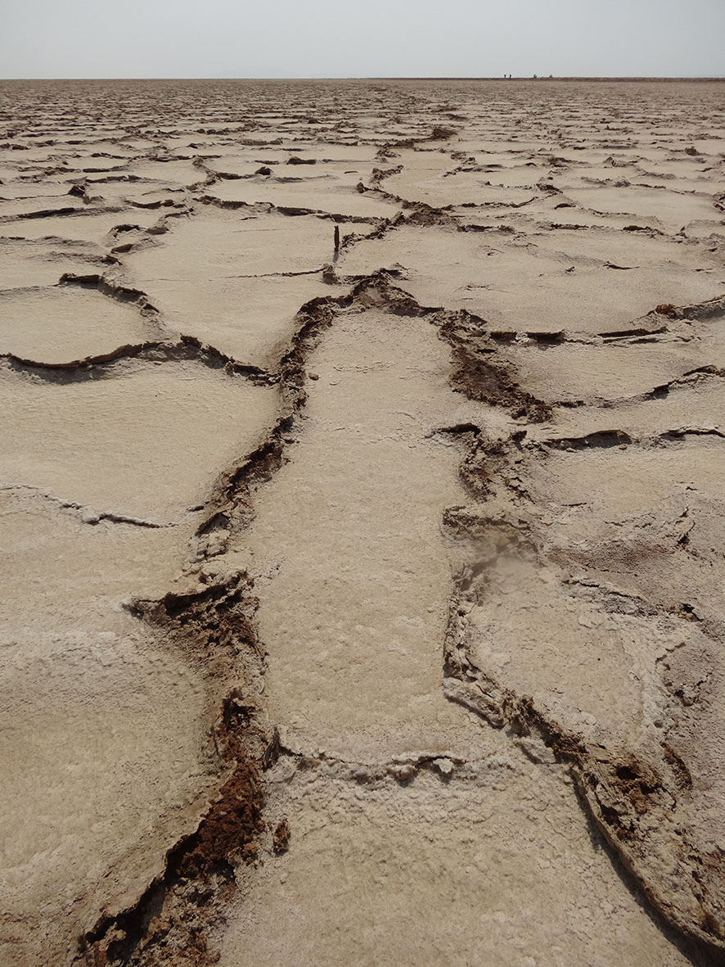
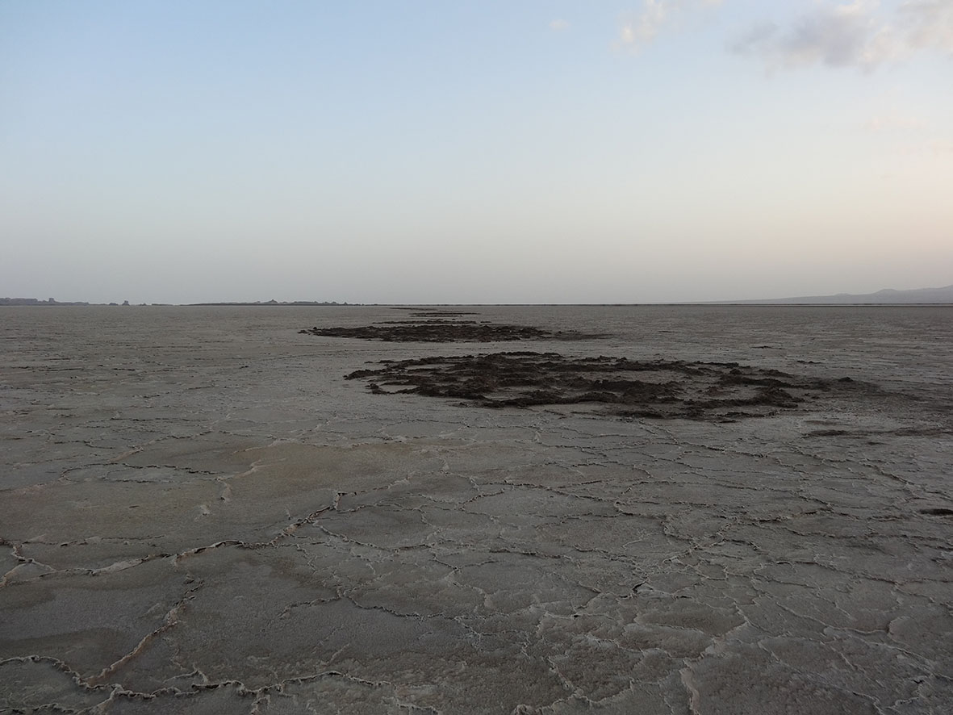
Portfolio
P10
Water upflows features along rift border fault system
Grid 1
Water upflows features along Yellow Lake Fissure

Slide 14
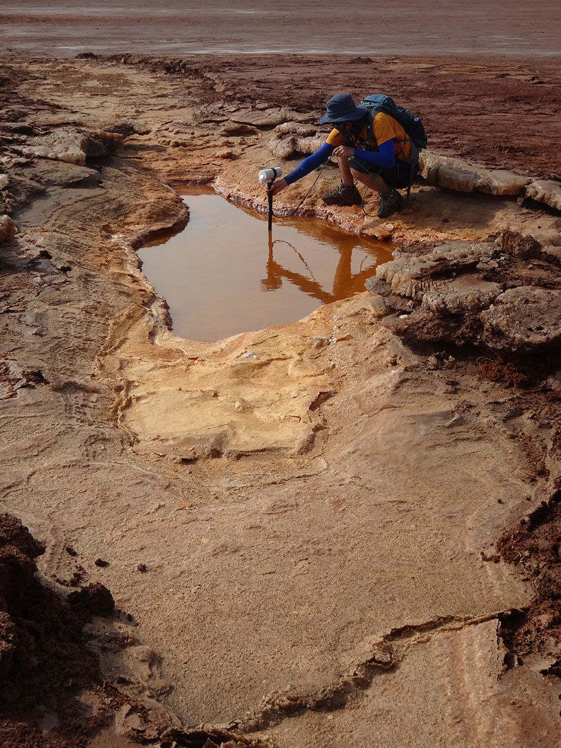
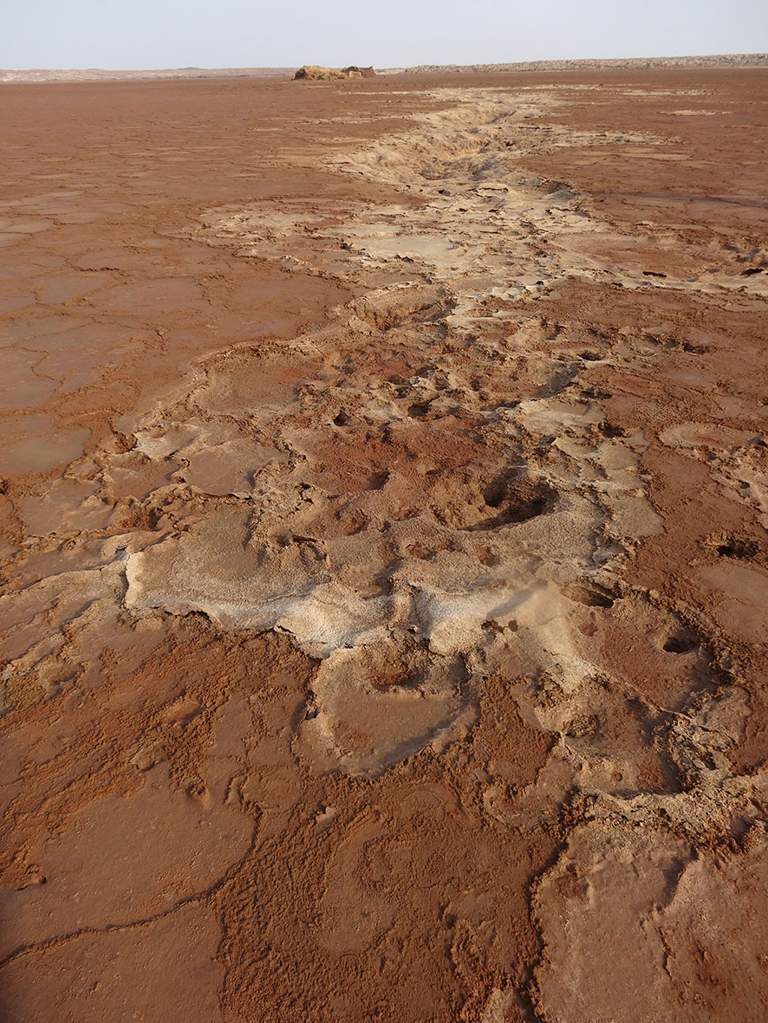
Portfolio
Grid 1
Still active yellow pool
Along Yellow Lake fissure
Open fissure depth > 150 cm
Grid 1
Yellow Lake Fissure segment
Reactivated since January 2018

Slide 15
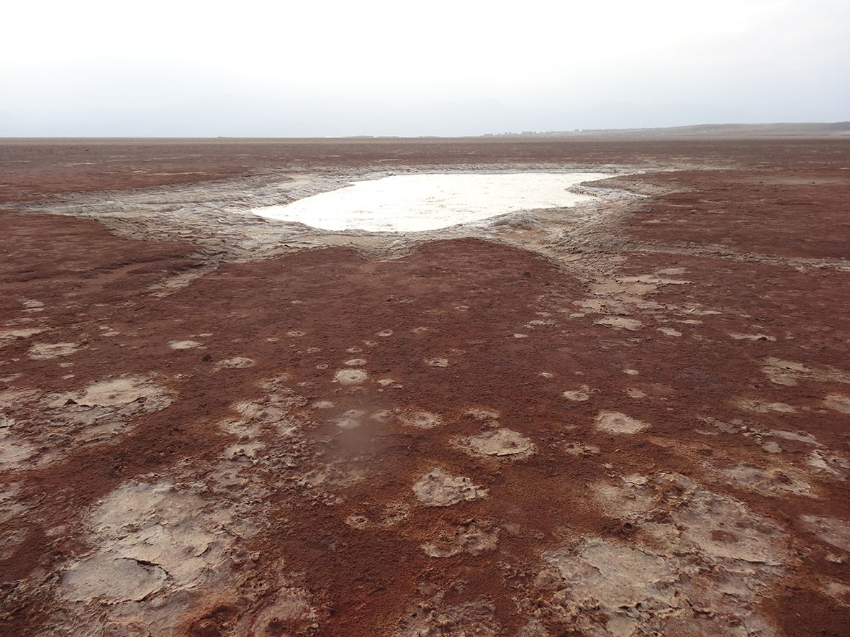
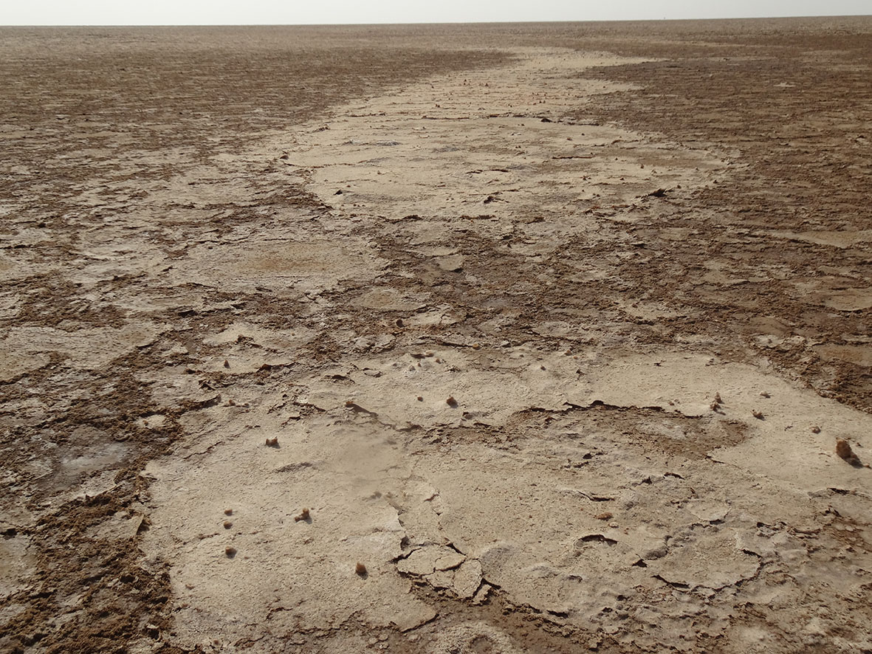
Portfolio
P3
Intensely bubbling reactivated salt lake ("White Lake")
in diffuse hydrothermal zone around Yellow Lake Fissure
Grid 2
Intense bubbling under salt plate
in Yellow Lake Fissure segment

Slide 16
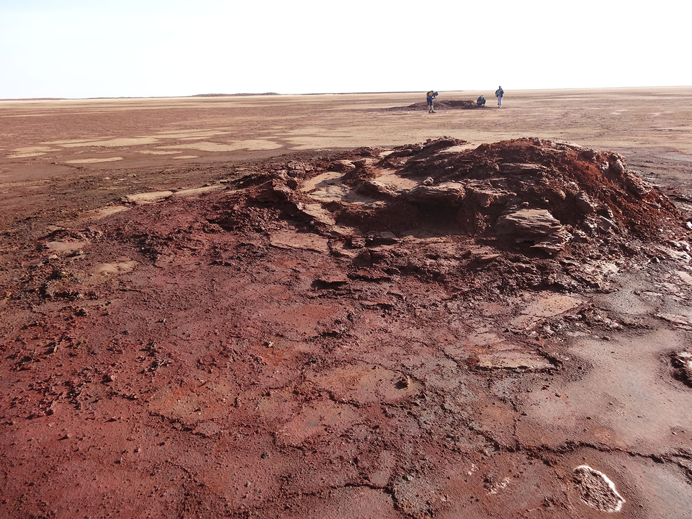
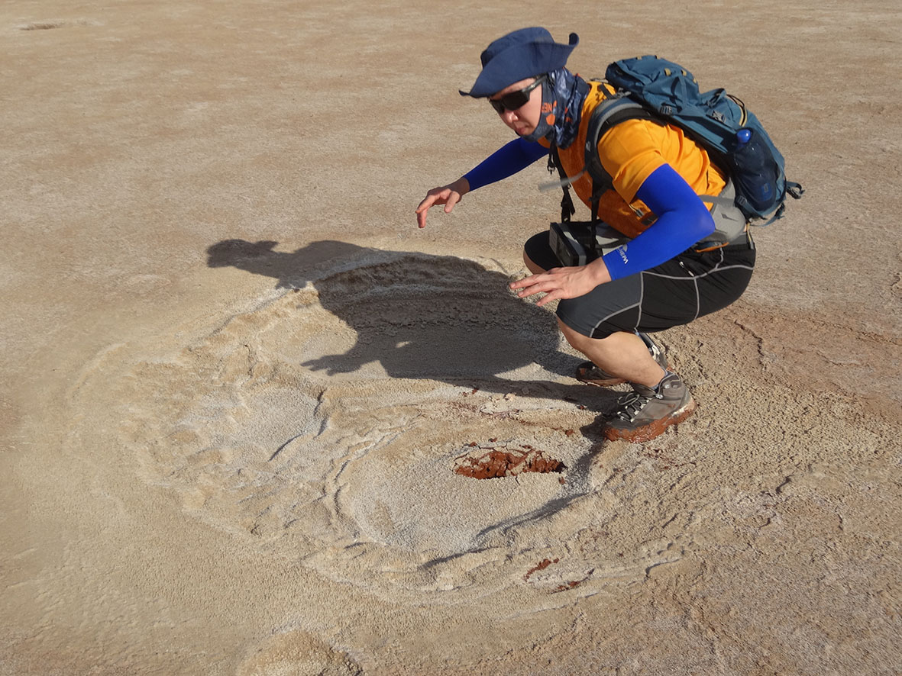
Portfolio
P3
Nascent diapirs
east of Yellow Lake Fissure
P3
Wet soil in diapir-rich area
east of Yellow Lake Fissure

Slide 17
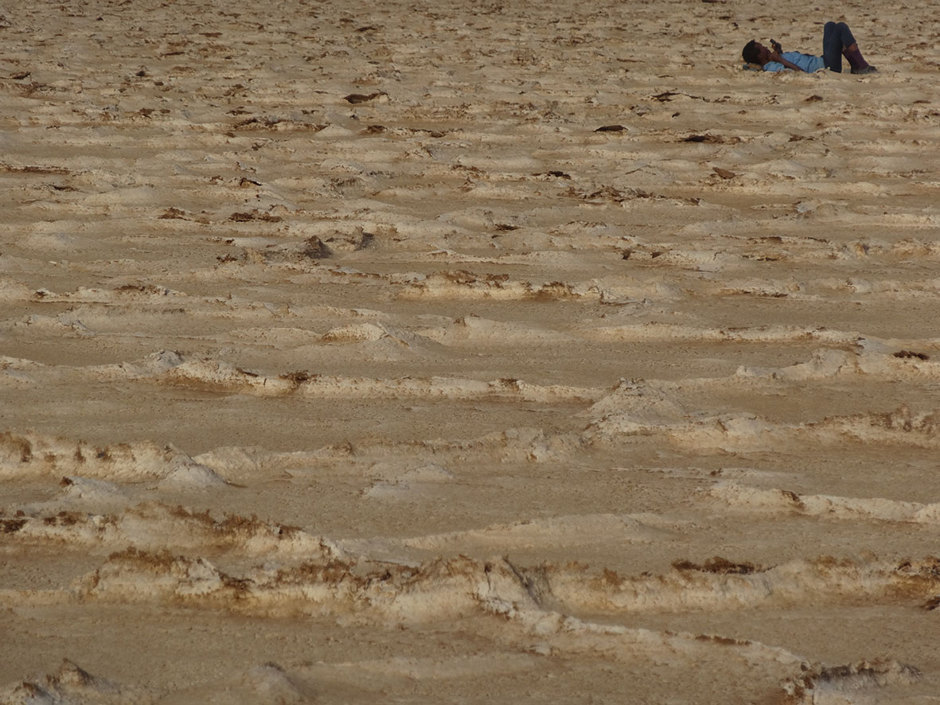
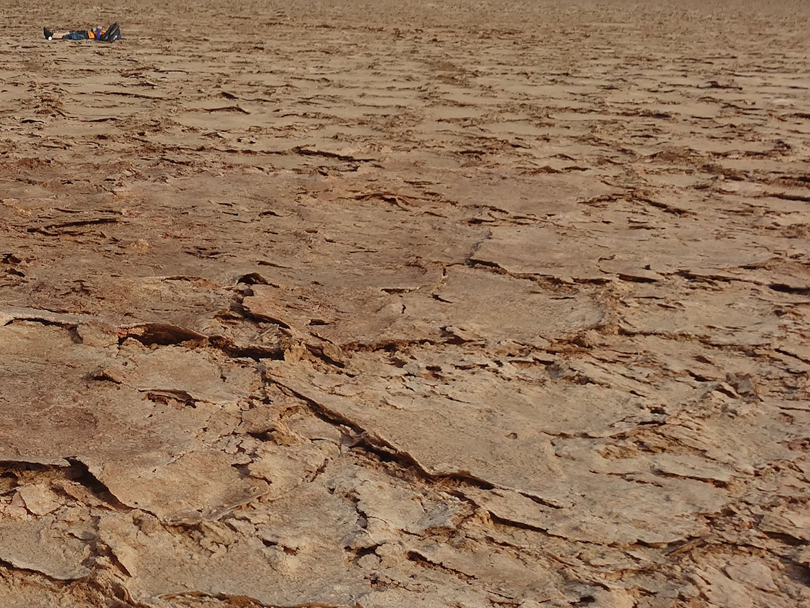
Portfolio
Grid 2
Police protecting scientist
Grid 2
Scientist feeling safe

Slide 18
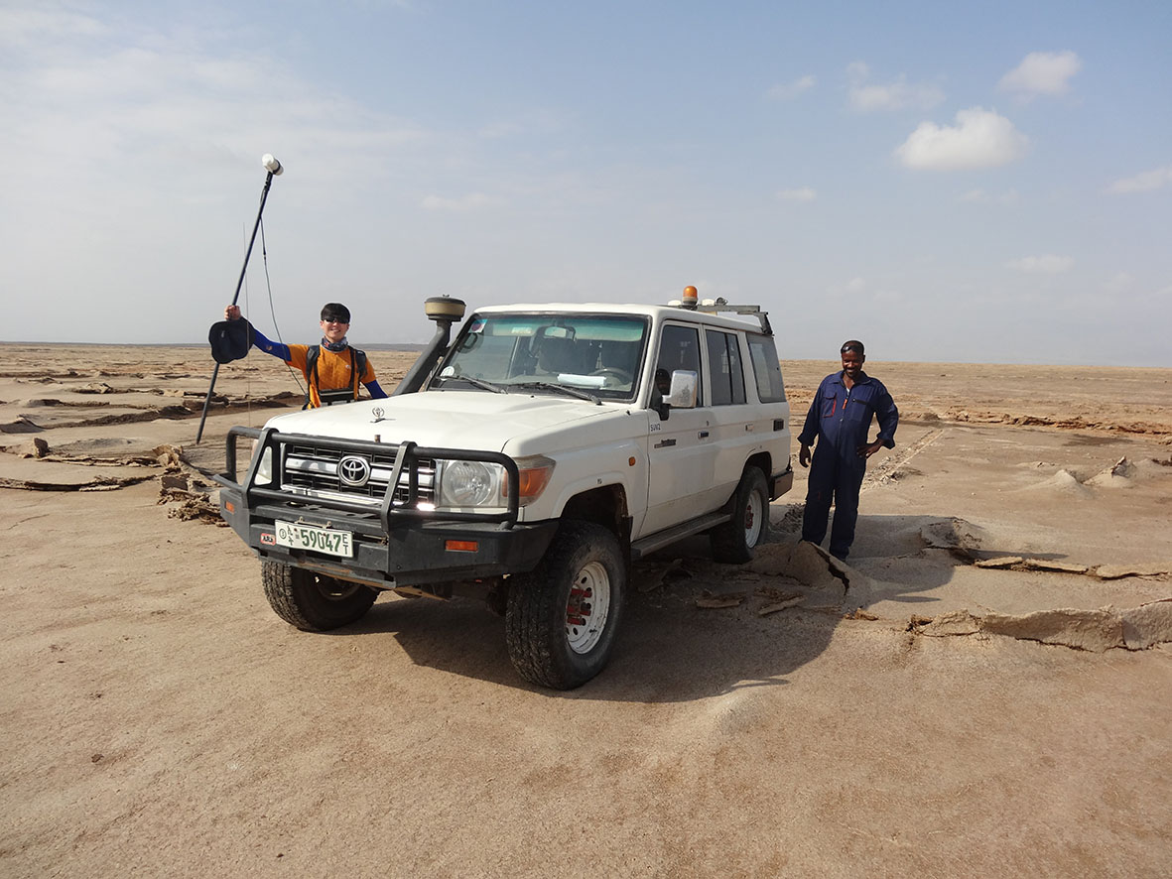
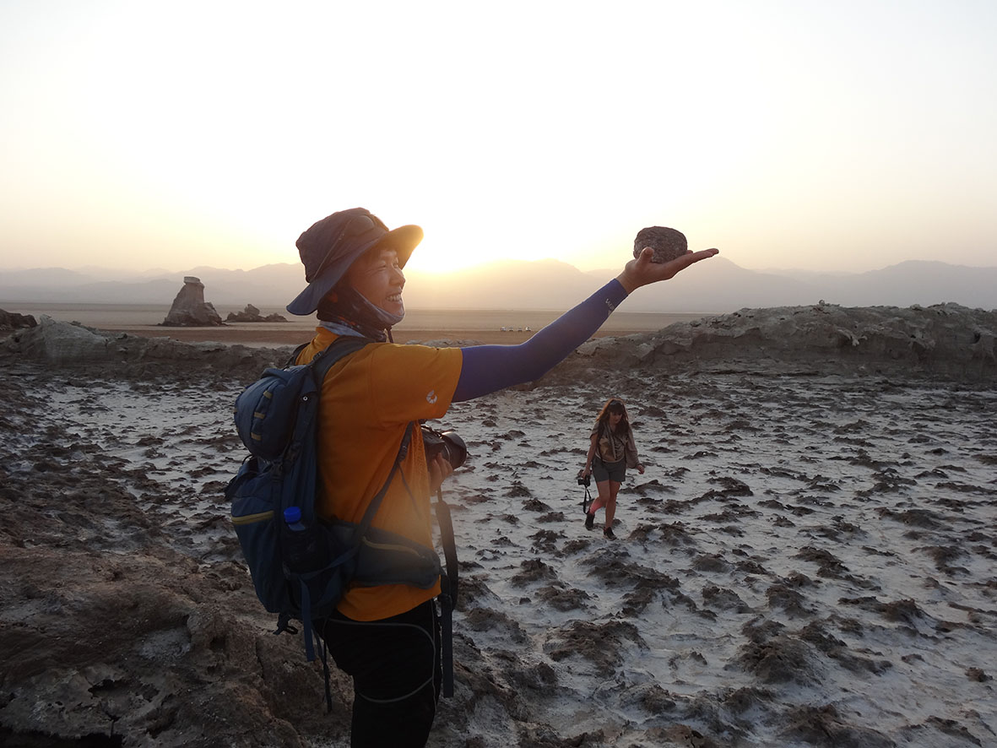
Portfolio
P9
Co-I relieved
Afternoon off in Dallol fractured area
Co-I finding mafic/ultramafic cannonball
(donated to Ben van Wyk de Vries for analyses)

Slide 19
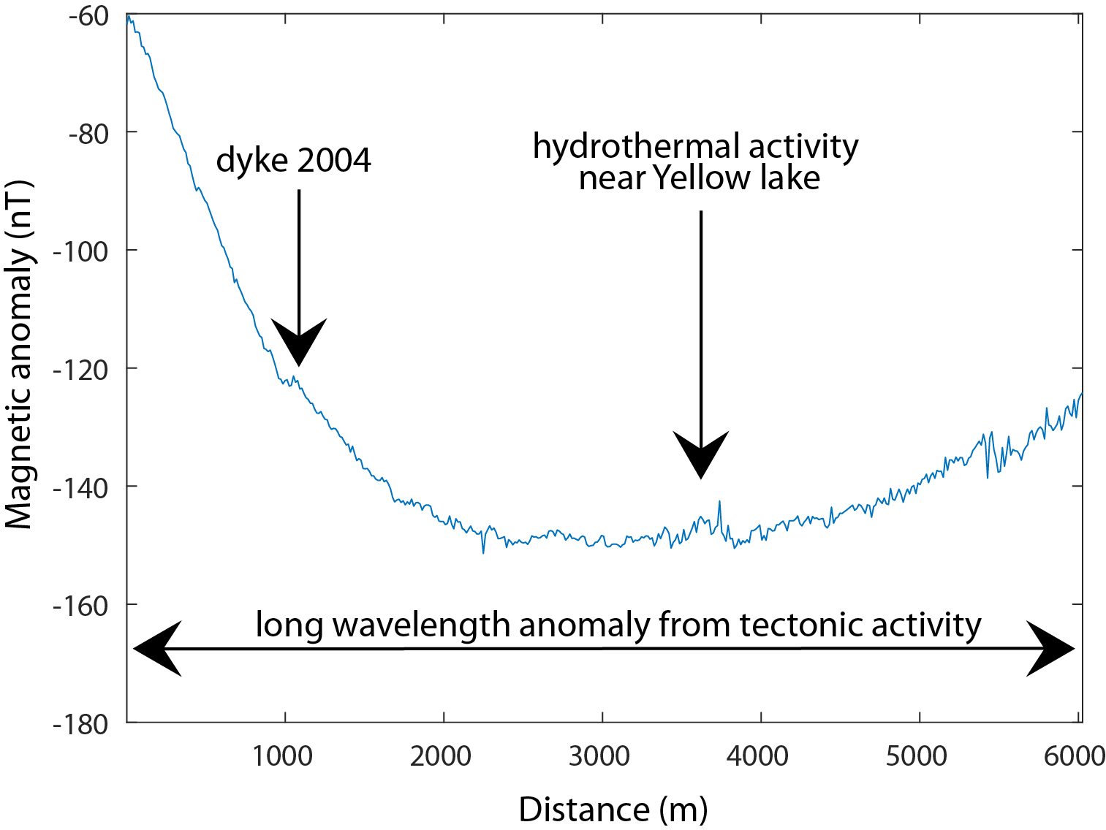
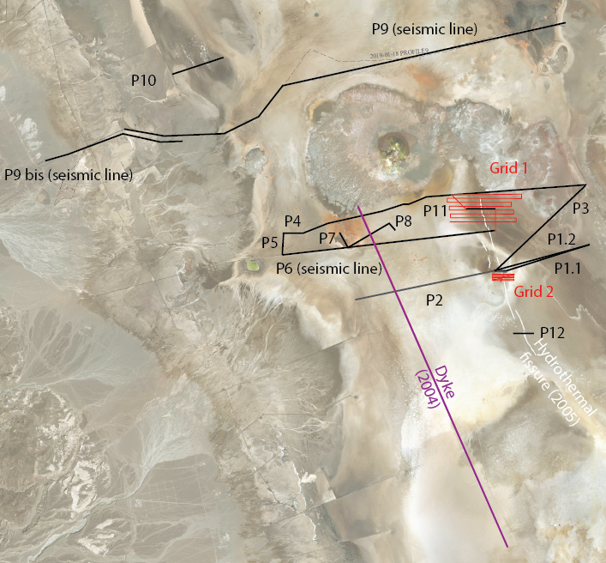
First results
PROFILE 6
Long wavelength: basement structure
Short wavelength: fractures (dykes, hydrothermal faults)

Slide 20
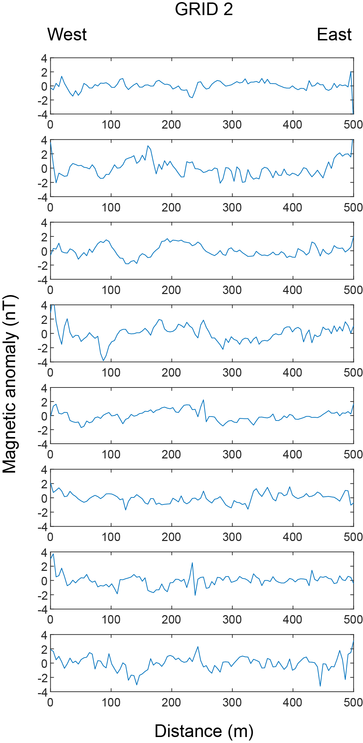
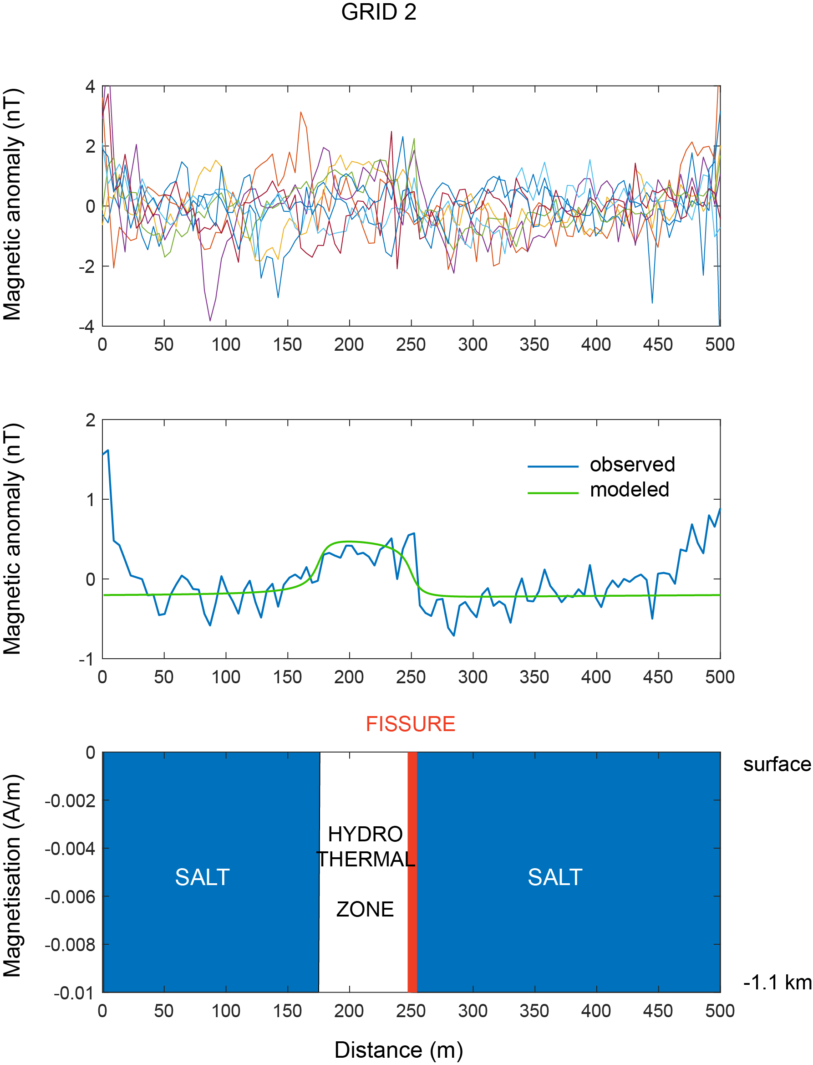
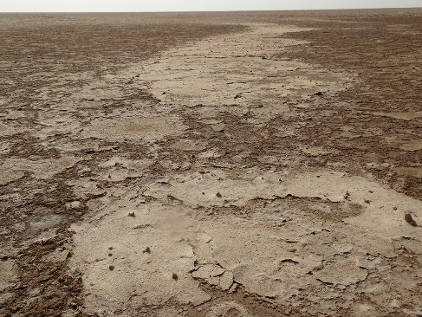
First results
GRID 2, spacing 4.3 m
Yellow Lake
Fissure segment

Slide 21
Summary
The 2005 Yellow Lake fissure has the magnetic signature of a hydrothermal crack the displacement of which destabilised its eastern wall
The 2004 dyke intrusion east of Black Mountain is confirmed; further modelling can provide further information onto dyke thickness
Outcome will sharpen our understanding of potential hydrothermal site locations and dynamics in volcanic-tectonic regions of Mars (Tharsis, Elysium, …)
Additionally: magmatic rock sampling in western Dallol will help characterise Dallol intrusive and/or extrusive magmatic activity (collaboration Univ. Clermont-Ferrand)

